Slide 1
Maximum likelihood estimation of regularisation parameters in high dimensional inverse problems: an empirical Bayesian approach
Ana Fernández Vidal
Marcelo Pereyra
Valentin De Bortoli
Alain Durmus
School of Mathematical and Computer Sciences, Heriot-Watt University
École normale supérieure Paris-Saclay,
CNRS, Université Paris-Saclay
Probability in the North-East – ICMS, Edinburgh- January 2020

Slide 2
High-dimensional Inverse Problems
We want to recover $x$ from the observation $y$
NOISE
UNKNOWN
IMAGE
LINEAR
OPERATOR
$$w\sim N(0,σ^{2}I)$$
OBSERVATION
A
+
$y=Ax+w$
$$x∈ℝ^{n}$$
- rank deficient
- small eigenvalues
$$y∈ℝ^{m}$$

Slide 3
High-dimensional Inverse Problems
We want to recover $x$ from the observation $y$
NOISE
UNKNOWN
IMAGE
LINEAR
OPERATOR
$$w\sim N(0,σ^{2}I)$$
OBSERVATION
A
+
$y=Ax+w$
$$x∈ℝ^{n}$$
- rank deficient
- small eigenvalues
$$y∈ℝ^{m}$$
We measure $y$, related to $x$ by a statistical model $p\left(y | x\right):$
PROBLEM: The recovery of $x$from $y$ is ill-posed or ill-conditioned
$$p\left(y | x\right)∝e^{− \frac{{\left\|y−Ax\right\|}_{2}^{2}}{2σ^{2}}}$$
LIKELIHOOD
DATA FIDELITY

Slide 4
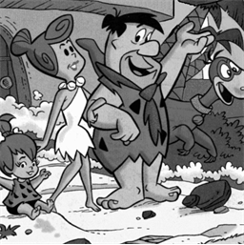
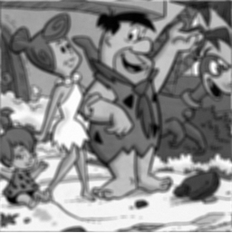
High-dimensional Inverse Problems
$${\hat{x}}_{ }∈\underset{x∈ℝ^{n}}{argmax}{ p\left(y | x\right)}$$
$${\hat{x}}_{ }∈\underset{x∈ℝ^{n}}{argmin}{{ \left\|Ax−y\right\|}_{2}^{2} }$$
$$original$$
$$observation y$$

Slide 5
High-dimensional Inverse Problems
$${\hat{x}}_{ }∈\underset{x∈ℝ^{n}}{argmax}{ p\left(y | x\right)}$$
$${\hat{x}}_{ }∈\underset{x∈ℝ^{n}}{argmin}{{ \left\|Ax−y\right\|}_{2}^{2} }$$
$$original$$
$$observation y$$
$$estimation {\hat{x}}_{ }$$

Slide 6
The Bayesian Framework
We use priors to reduce uncertainty and deliver accurate estimates.
HYPERPARAMETER
REGULARISER
$$p\left(x|θ\right)=\frac{e^{−θ φ\left(x\right)}}{Z(θ)}$$
$We will assume that φ\left(x\right)$ is
-convex
-possibly non-smooth
PRIOR DISTRIBUTION
REGULARISATION: $φ(x)$ penalises undesired properties and the regularisation parameter $θ$ controls the intensity of the penalisation.
Notes:
2min

Slide 7
The Bayesian Framework
We obtain the posterior using Bayes’ rule.
HYPERPARAMETER
REGULARISER
$$p\left(x|θ\right)=\frac{e^{−θ φ\left(x\right)}}{Z(θ)}$$
$$p\left(y | x\right)∝e^{− \frac{{\left\|y−Ax\right\|}_{2}^{2}}{2σ^{2}}}$$
LIKELIHOOD
DATA FIDELITY
PRIOR DISTRIBUTION
BAYES’ RULE
POSTERIOR
$p\left(x | y,θ\right)=\frac{p\left(y|x\right)p\left(x|θ\right)}{p(y|θ)}$ $\text{∝}$ $e^{−\frac{{\left\|y−Ax\right\|}_{2}^{2}}{2σ^{2}}− θ φ(x)}$
LOG-CONCAVE

Slide 8
Bayesian Formulation of the problem
$p\left(x | y,θ\right)$ $\text{∝}$ $e^{−\frac{{\left\|y−Ax\right\|}_{2}^{2}}{2σ^{2}}− θ φ(x)}$
POSTERIOR
The predominant Bayesian approach in imaging is MAP estimation which can be computed very eﬃciently by convex optimisation:
$${\hat{x}}_{MAP} _{ }=\underset{x∈ℝ^{n}}{argmax}{p\left(x | y,θ\right)}$$
CONVEX
$${\hat{x}}_{MAP} _{ }=\underset{x∈ℝ^{n}}{argmin}{\frac{{\left\|y−Ax\right\|}_{2}^{2}}{2σ^{2}}+ θ φ(x)}$$

Slide 9
Bayesian Formulation of the problem
How do we choose the regularisation parameter?
$${\hat{x}}_{MAP} _{ }=\underset{x∈ℝ^{n}}{argmin}{\frac{{\left\|y−Ax\right\|}_{2}^{2}}{2σ^{2}}+ θ φ(x)}$$

Slide 10
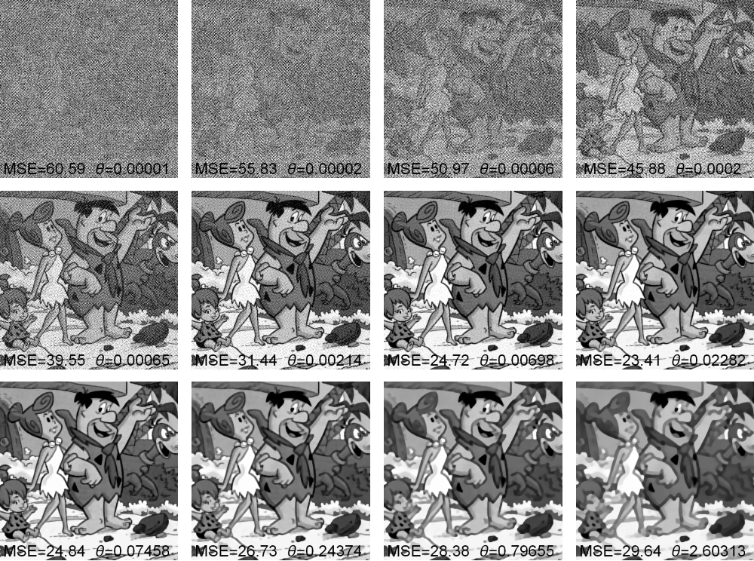
Effect of Regularisation parameter

Slide 11
Effect of Regularisation parameter
DATA
$$θ≈0.02$$
PRIOR

Slide 12
Overview of the talk
Existing methods for selecting the regularisation parameter
New method: Empirical Bayesian estimation of regularisation parameters
How to generate random samples in high dimensions
Results and experiments
Conclusions and future work

Slide 13
Choosing the regularisation parameter
Non-Bayesian approaches
Cross-validation (exhaustive-search)
Discrepancy principles and L-curves
Stein-based methods (SURE)
SUGAR (computes gradient of SURE, solver dependent)
Bayesian approaches
Hierarchical: propose prior for $θ$.
Marginalisation $p(x|y)= \int_{ℝ^{+}}^{ }{p\left(x,θ | y\right)dθ}$
Joint MAP estimation $\left(\hat{x},\hat{θ}\right)$
Empirical Bayes
Choose $θ$ by maximizing marginal likelihood
$${\left\|y−A {\hat{x}}_{MAP}(θ) _{ }\right\|}_{2}^{2}$$

Slide 14
Empirical Bayes
We want to find $\hat{θ}$ that maximizes the marginal likelihood $p(y|θ)$:
$\left\{\begin{aligned}p(y|θ)= \int_{ℝ^{n}}^{ }{p\left(y,x | θ\right)dx} \\ {\hat{θ_{ }}}_{MLE} =\begin{matrix} \\ \begin{matrix} \\ argmax \\ θ∈Θ\end{matrix}\end{matrix}p(y|θ) \end{aligned} \right.$
EMPIRICAL BAYES
POSTERIOR
$$p\left(x | y,{\hat{θ_{ }}}_{MLE}\right)$$

Slide 15
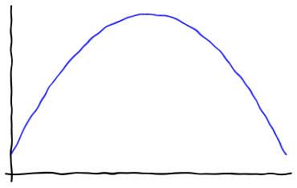
Empirical Bayes
We want to find ${\hat{θ}}_{ }$that maximizes the marginal likelihood $p(y|θ)$:
$p\left(y | θ\right)=\int_{ℝ^{n}}^{ }{p\left(y,x | θ\right)dx}=\int_{ℝ^{n}}^{ }{p\left(y | x\right) p\left(x | θ\right)dx}$
$$\log{p(y|θ)}$$
$$θ$$
$${\hat{θ_{ }}}_{MLE}$$
Notes:
6.50

Slide 16
Empirical Bayes
We want to find $\hat{θ}$ that maximizes the marginal likelihood $p(y|θ)$:
$p(y|θ)= \int_{ℝ^{n}}^{ }{p\left(y | x\right) p\left(x | θ\right)dx}$
$$\log{p(y|θ)}$$
PROJECTED GRADIENT ALGORITHM
$θ_{ }^{t+1}=𝒫_{Θ}[θ_{ }^{t}+δ_{t}∇_{θ}\log{p(y|θ_{ }^{t})}$]
$$θ$$
$${\hat{θ_{ }}}_{MLE}$$
$$θ^{t+1}$$
$$θ^{t}$$
$$∇_{θ}\log{p(y|θ_{ }^{t})}$$

Slide 17
Empirical Bayes
We want to find $\hat{θ}$ that maximizes the marginal likelihood $p(y|θ)$:
$p(y|θ)= \int_{ℝ^{n}}^{ }{p\left(y | x\right) p\left(x | θ\right)dx}$
$$\frac{e^{−θ φ\left(x\right)}}{Z(θ)}$$
$$\log{p(y|θ)}$$
PROJECTED GRADIENT ALGORITHM
$θ_{ }^{t+1}=𝒫_{Θ}[θ_{ }^{t}+δ_{t}∇_{θ}\log{p(y|θ_{ }^{t})}$]
$$θ$$
$${\hat{θ_{ }}}_{MLE}$$
$$θ^{t+1}$$
$$θ^{t}$$
$$∇_{θ}\log{p(y|θ_{ }^{t})}$$

Slide 18
Empirical Bayes
We want to find $\hat{θ}$ that maximizes the marginal likelihood $p(y|θ)$:
$p(y|θ)= \int_{ℝ^{n}}^{ }{p\left(y | x\right) p\left(x | θ\right)dx}$
$$\frac{e^{−θ φ\left(x\right)}}{Z(θ)}$$
$$\log{p(y|θ)}$$
PROJECTED GRADIENT ALGORITHM
$θ_{ }^{t+1}=𝒫_{Θ}[θ_{ }^{t}+δ_{t}∇_{θ}\log{p(y|θ_{ }^{t})}$]
$$θ$$
$${\hat{θ_{ }}}_{MLE}$$
$$θ^{t+1}$$
$$θ^{t}$$
$$∇_{θ}\log{p(y|θ_{ }^{t})}$$
We developed an efficient stochastic optimization scheme for computing ${\hat{θ_{ }}}_{MLE}$

Slide 19
Empirical Bayes
PROJECTED GRADIENT ALGORITHM
$θ_{ }^{t+1}=𝒫_{Θ}[θ_{ }^{t}+δ_{t}∇_{θ}\log{p(y|θ_{ }^{t})})$]

Slide 20
Empirical Bayes
$p\left(y,x | θ\right)\text{∝ }e^{−\frac{{\left\|y−Ax\right\|}_{2}^{2}}{2σ^{2}}}$ $\frac{e^{−θ φ\left(x\right)}}{Z(θ)}$
PROJECTED GRADIENT ALGORITHM
$θ_{ }^{t+1}=𝒫_{Θ}[θ_{ }^{t}+δ_{t}∇_{θ}\log{p(y|θ_{ }^{t})})$]
Fisher’s identity
$$∇_{θ}\log{p\left(y | θ_{ }^{ }\right)}=𝔼_{x|y,θ_{ }}\left[∇_{θ}\log{ p\left(x,y | θ_{ }^{ }\right)}\right]$$
$${∇_{θ}\log{p(y|θ_{ }^{ })}=𝔼}_{x|y,θ_{ }}\left[∇_{θ}\log{ p\left(x,y | θ_{ }^{ }\right)}\right]$$

Slide 21
Empirical Bayes
$p\left(y,x | θ\right)\text{∝ }e^{−\frac{{\left\|y−Ax\right\|}_{2}^{2}}{2σ^{2}}}$ $\frac{e^{−θ φ\left(x\right)}}{Z(θ)}$
PROJECTED GRADIENT ALGORITHM
$θ_{ }^{t+1}=𝒫_{Θ}[θ_{ }^{t}+δ_{t}∇_{θ}\log{p(y|θ_{ }^{t})})$]
Fisher’s identity
$$∇_{θ}\log{p\left(y | θ_{ }^{ }\right)}=𝔼_{x|y,θ_{ }}\left[∇_{θ}\log{ p\left(x,y | θ_{ }^{ }\right)}\right]$$
$${∇_{θ}\log{p(y|θ_{ }^{ })}=𝔼}_{x|y,θ_{ }}\left[−φ\left(x\right) \right]−∇_{θ}\log{Z\left(θ\right)}$$

Slide 22
Empirical Bayes
$p\left(y,x | θ\right)\text{∝ }e^{−\frac{{\left\|y−Ax\right\|}_{2}^{2}}{2σ^{2}}}$ $\frac{e^{−θ φ\left(x\right)}}{Z(θ)}$
PROJECTED GRADIENT ALGORITHM
$θ_{ }^{t+1}=𝒫_{Θ}[θ_{ }^{t}+δ_{t}∇_{θ}\log{p(y|θ_{ }^{t})})$]
Fisher’s identity
$$∇_{θ}\log{p\left(y | θ_{ }^{ }\right)}=𝔼_{x|y,θ_{ }}\left[∇_{θ}\log{ p\left(x,y | θ_{ }^{ }\right)}\right]$$
$${∇_{θ}\log{p(y|θ_{ }^{ })}=𝔼}_{x|y,θ_{ }}\left[−φ\left(x\right) \right]−∇_{θ}\log{Z\left(θ\right)}$$
We can approximate $𝔼_{x|y,θ_{ }}$ with Monte Carlo estimate

Slide 23
Empirical Bayes
PROJECTED GRADIENT ALGORITHM
$θ_{ }^{t+1}=𝒫_{Θ}[θ_{ }^{t}+δ_{t}∇_{θ}\log{p(y|θ_{ }^{t})})$]
$$p\left(x|θ\right)=\frac{e^{−θ φ\left(x\right)}}{Z(θ)}$$
Fisher’s identity
$$∇_{θ}\log{p\left(y | θ_{ }^{ }\right)}=𝔼_{x|y,θ_{ }}\left[∇_{θ}\log{ p\left(x,y | θ_{ }^{ }\right)}\right]$$
PRIOR DISTRIBUTION
$${∇_{θ}\log{p(y|θ_{ }^{ })}=𝔼}_{x|y,θ_{ }}\left[−φ\left(x\right) \right]−∇_{θ}\log{Z\left(θ\right)}$$

Slide 24
Empirical Bayes
PROJECTED GRADIENT ALGORITHM
$θ_{ }^{t+1}=𝒫_{Θ}[θ_{ }^{t}+δ_{t}∇_{θ}\log{p(y|θ_{ }^{t})})$]
Fisher’s identity
$$∇_{θ}\log{p\left(y | θ_{ }^{ }\right)}=𝔼_{x|y,θ_{ }}\left[∇_{θ}\log{ p\left(x,y | θ_{ }^{ }\right)}\right]$$
$${∇_{θ}\log{p(y|θ_{ }^{ })}=𝔼}_{x|y,θ_{ }}\left[−φ\left(x\right) \right]−∇_{θ}\log{Z\left(θ\right)}$$
$$−\frac{d}{dθ_{ }}\log{Z\left(θ\right)}=\frac{n}{k θ}$$
$φ\left(x\right)$ k-homogeneous
Scalar $θ$

Slide 25
Empirical Bayes
PROJECTED GRADIENT ALGORITHM
$θ_{ }^{t+1}=𝒫_{Θ}[θ_{ }^{t}+δ_{t}∇_{θ}\log{p(y|θ_{ }^{t})})$]
Fisher’s identity
$$∇_{θ}\log{p\left(y | θ_{ }^{ }\right)}=𝔼_{x|y,θ_{ }}\left[∇_{θ}\log{ p\left(x,y | θ_{ }^{ }\right)}\right]$$
$${∇_{θ}\log{p(y|θ_{ }^{ })}=𝔼}_{x|y,θ_{ }}\left[−φ\left(x\right) \right]−∇_{θ}\log{Z\left(θ\right)}$$
${−∇}_{θ}\log{Z\left(θ\right)}$= $𝔼_{x|θ_{ }}[φ\left(x\right)]$
$$∇_{θ}\log{p(y|θ_{ }^{ })}=𝔼_{x|y,θ_{ }}\left[−φ\left(x\right) \right]+𝔼_{x|θ_{ }}\left[φ\left(x\right) \right]$$

Slide 26
Empirical Bayes
PROJECTED GRADIENT ALGORITHM
$θ_{ }^{t+1}=𝒫_{Θ}[θ_{ }^{t}+δ_{t}∇_{θ}\log{p(y|θ_{ }^{t})})$]
$∇_{θ}\log{p(y|θ_{ }^{ })}=𝔼_{x|θ_{ }}\left[φ\left(x\right) \right]$ $−$ $𝔼_{x|y,θ_{ }}\left[φ\left(x\right) \right]$
We can approximate $𝔼_{x|y,θ_{ }}$ and $𝔼_{x|θ_{ }}$with Monte Carlo estimate

Slide 27
Empirical Bayes
STOCHASTIC APPROXIMATION PROXIMAL GRADIENT ALGORITHM (SAPG)
$$X^{t+1}\sim M_{θ^{t}}^{ }\left(X | y,θ_{ }^{t}, X^{t}\right)$$
POSTERIOR
$𝔼_{x|θ_{ }}\left[φ\left(x\right) \right]$ $−$ $𝔼_{x|y,θ_{ }}\left[φ\left(x\right) \right]$
$$U^{t+1}\sim K_{θ^{t}}^{ }\left(U | θ_{ }^{t}, U^{t}\right)$$
PRIOR
$θ_{ }^{t+1}=𝒫_{Θ}[θ_{ }^{t}+δ_{t}(φ\left(U^{t+1}\right)−φ\left(X^{t+1}\right))$]
We approximate each expectation with only one Montecarlo sample.

Slide 28
Empirical Bayes
STOCHASTIC APPROXIMATION PROXIMAL GRADIENT ALGORITHM (SAPG)
$$X^{t+1}\sim M_{θ^{t}}^{ }\left(X | y,θ_{ }^{t}, X^{t}\right)$$
$$p\left(x | y,{\hat{θ_{ }}}_{MLE}\right)$$
POSTERIOR
$$U^{t+1}\sim K_{θ^{t}}^{ }\left(U | θ_{ }^{t}, U^{t}\right)$$
PRIOR
$$p\left(x | {\hat{θ_{ }}}_{MLE}\right)$$
$${\hat{θ_{ }}}_{MLE}$$
$θ_{ }^{t+1}=𝒫_{Θ}[θ_{ }^{t}+δ_{t}(φ\left(U^{t+1}\right)−φ\left(X^{t+1}\right))$]
arXiv:1911.11709v1 [stat.ME] 26 Nov 2019

Slide 29
How to generate the samples
$$X^{t+1}\sim M_{θ^{t}}^{ }\left(X | y,θ_{ }^{t}, X^{t}\right)$$
POSTERIOR
$$U^{t+1}\sim K_{θ^{t}}^{ }\left(U | θ_{ }^{t}, U^{t}\right)$$
PRIOR
UNADJUSTED LANGEVIN ALGORITHM (ULA)
$$W^{t+1}\sim N\left(0, 𝕀 \right)$$
$$M_{θ^{ }}^{ }: x^{t+1}=x^{t}+γ ∇_{x}\log{p\left(x^{t} | y,θ\right)}+\sqrt{2γ} W^{t+1}$$
$$^{−\frac{{\left\|y−Ax\right\|}_{2}^{2}}{2σ^{2}}− θ φ(x)}$$
$φ$ may be non-differentiable

Slide 30
How to generate the samples
$$X^{t+1}\sim M_{θ^{t}}^{ }\left(X | y,θ_{ }^{t}, X^{t}\right)$$
POSTERIOR
$$U^{t+1}\sim K_{θ^{t}}^{ }\left(U | θ_{ }^{t}, U^{t}\right)$$
PRIOR
UNADJUSTED LANGEVIN ALGORITHM (ULA)
$$W^{t+1}\sim N\left(0, 𝕀 \right)$$
$$M_{θ^{ }}^{ }: x^{t+1}=x^{t}+γ{ ∇}_{x}\log{p\left(x^{t} | y,θ\right)}+\sqrt{2γ} W^{t+1}$$
$$^{−\frac{{\left\|y−Ax\right\|}_{2}^{2}}{2σ^{2}}− θ φ(x)}$$
$${\tilde{φ}}_{λ}(x)$$
Moreau Envelope

Slide 31
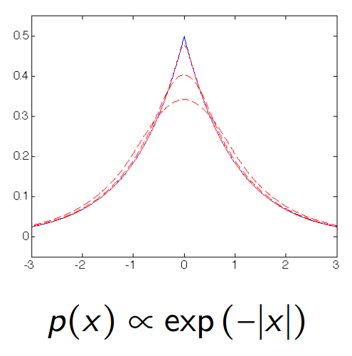
How to generate the samples
UNADJUSTED LANGEVIN ALGORITHM (ULA)
$$W^{t+1}\sim N\left(0, 𝕀 \right)$$
$$M_{θ^{ }}^{ }: x^{t+1}=x^{t}+γ{ ∇}_{x}\log{p\left(x^{t} | y,θ\right)}+\sqrt{2γ} W^{t+1}$$
$$^{−\frac{{\left\|y−Ax\right\|}_{2}^{2}}{2σ^{2}}− θ φ(x)}$$
$${\tilde{φ}}_{λ}(x)$$
Moreau Envelope
infimal convolution
Moreau-Yosida regularisation controlled by $λ$
$${\tilde{φ}}_{λ}=\inf_{u∈ℝ^{d}}\left\{φ\left(u\right)−{\left(2λ\right)}^{−1} {\left\|u−x\right\|}_{2}^{2}\right\}$$

Slide 32
How to generate the samples
How to generate the samples
$$X^{t+1}\sim M_{θ^{t}}^{ }\left(X | y,θ_{ }^{t}, X^{t}\right)$$
POSTERIOR
$$U^{t+1}\sim K_{θ^{t}}^{ }\left(U | θ_{ }^{t}, U^{t}\right)$$
PRIOR
MOREAU-YOSIDA UNADJUSTED LANGEVIN ALGORITHM (MYULA)
$$M_{θ^{ }}^{ }:{ X}^{t+1}=X^{t}−γ_{x} \left( \frac{A^{T}\left(AX^{t}−y\right)}{σ^{2}} + \frac{X^{t}−prox_{φ}^{λθ}\left(X^{t}\right)}{λ} \right)+\sqrt{2γ_{x}} W^{t+1}$$
$$W^{t+1}\sim N\left(0, 𝕀 \right)$$
$${∇_{x}\tilde{φ}}_{λ}(x)$$
$$∇_{x}$$
$$\frac{{\left\|y−AX^{t}\right\|}_{2}^{2}}{2σ^{2}}$$
$$prox_{φ}^{λθ}\left(x\right)=\underset{\tilde{x}∈ℝ^{n}}{argmin}\left\{φ\left(\tilde{x}\right)+{\left\|\tilde{x}−x\right\|}_{2}^{2}/2λθ\right\}$$
32

Slide 33
How to generate the samples
How to generate the samples
$$X^{t+1}\sim M_{θ^{t}}^{ }\left(X | y,θ_{ }^{t}, X^{t}\right)$$
POSTERIOR
$$U^{t+1}\sim K_{θ^{t}}^{ }\left(U | θ_{ }^{t}, U^{t}\right)$$
PRIOR
MOREAU-YOSIDA UNADJUSTED LANGEVIN ALGORITHM (MYULA)
$$M_{θ^{ }}^{ }: X^{t+1}=X^{t}−γ_{x} \left( \frac{A^{T}\left(AX^{t}−y\right)}{σ^{2}} + \frac{X^{t}−prox_{φ}^{λθ}\left(X^{t}\right)}{λ} \right)+\sqrt{2γ_{x}} W^{t+1}$$
$$K_{θ^{ }}^{ }: U^{t+1}=U^{t}−γ_{u} \left( \frac{U^{t}−prox_{φ}^{λθ}\left(U^{t}\right)}{λ} \right)+\sqrt{2γ_{u}} W^{t+1}$$
arXiv:1612.07471v1 [stat.CO]
33

Slide 34
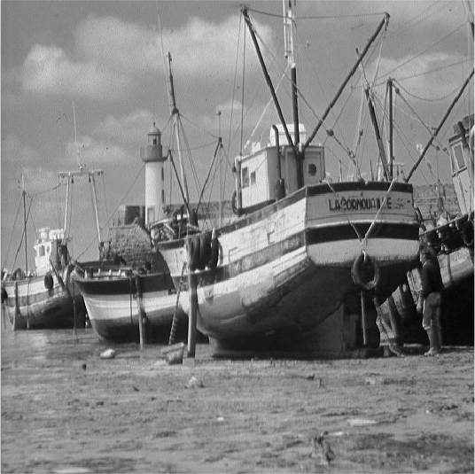
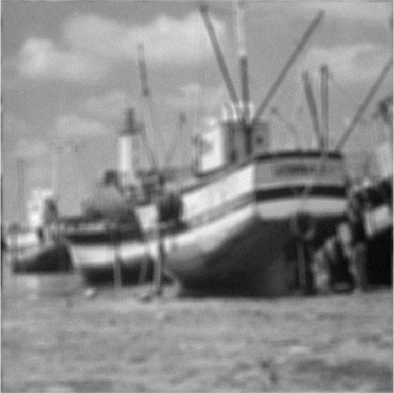
Numerical Experiments
TV non-blind deconvolution
NOISE
SNR=20dB
$$w\sim N(0,σ^{2}I)$$
uniform blur 9x9 pixels
+
$$512×512$$
$$512×512$$
$$x∈ℝ^{262144}$$
$$y∈ℝ^{262144}$$
Regularisation $→$ $φ\left(x\right)=TV\left(x\right)$
$$−\frac{d}{dθ_{ }}\log{Z\left(θ\right)}=\frac{n}{k θ}$$
$$X^{t+1}\sim M_{θ^{t}}^{ }\left(X | y,θ_{ }^{t}, X^{t}\right)$$
POSTERIOR
$${∇_{θ}\log{p(y|θ_{ }^{ })}≈}_{ }\frac{n}{θ}−φ\left(X^{t+1}\right)$$
$φ\left(x\right)$ k-homogeneous
Scalar $θ$

Slide 35
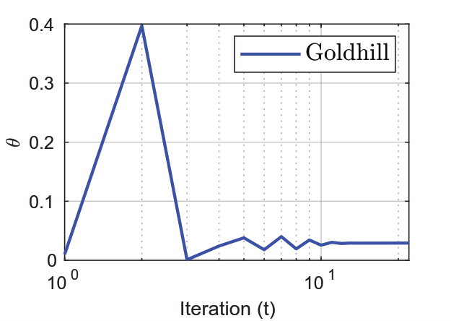
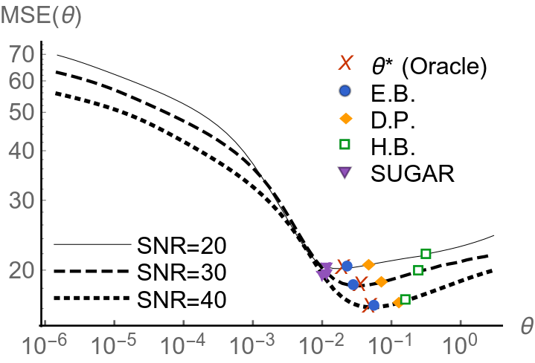
Numerical Experiments
TV non-blind deconvolution

Slide 36
Numerical Experiments
TV non-blind deconvolution
Discrepancy: Morozov 1984
SUGAR: arXiv:1405.1164v2
Hierarchical Bayes: Pereyra,
Bioucas-Dias & Figueiredo 2015

Slide 37
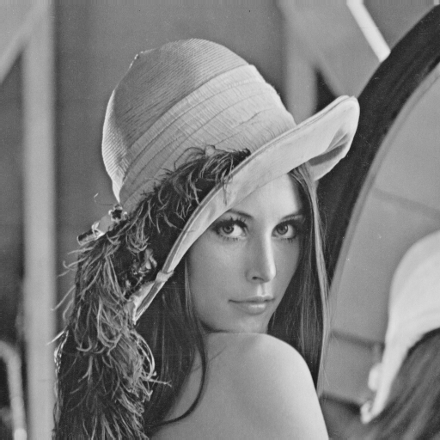
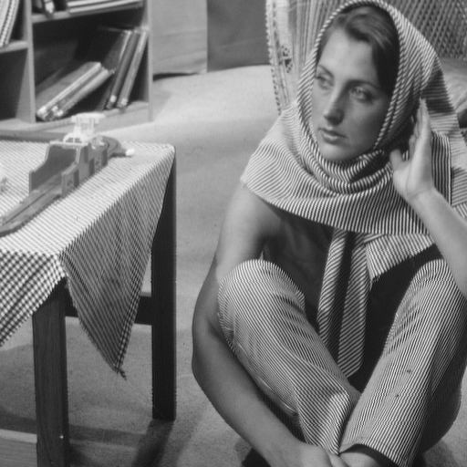
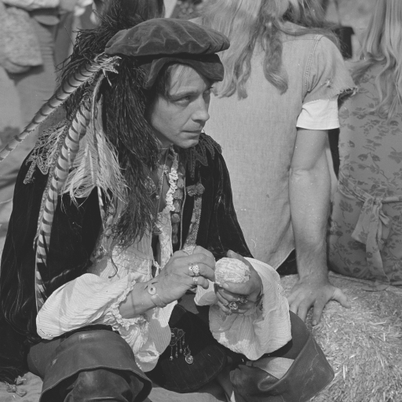
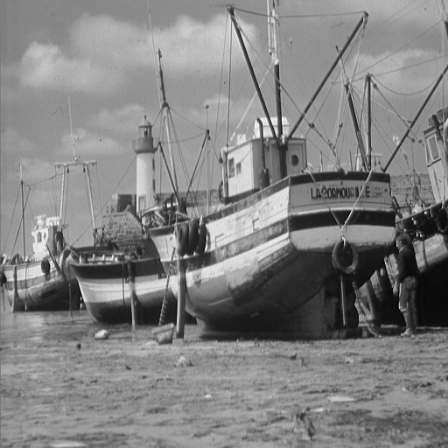
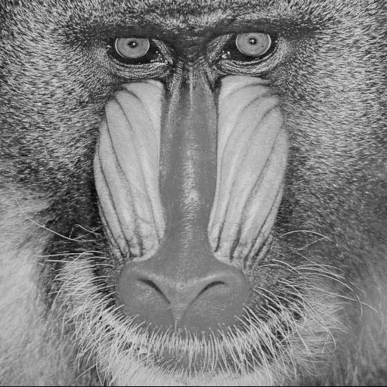
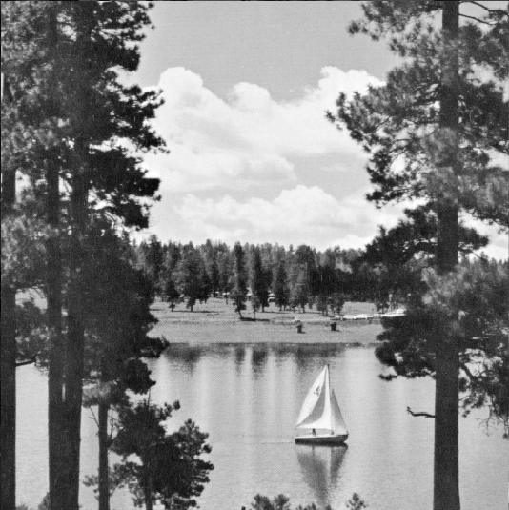
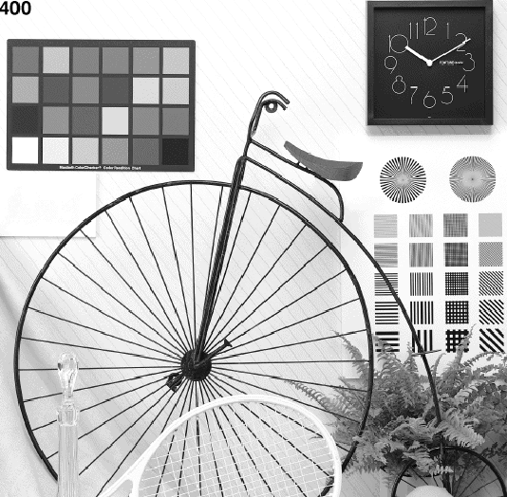
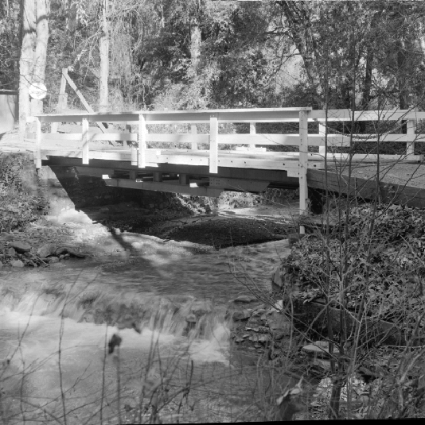
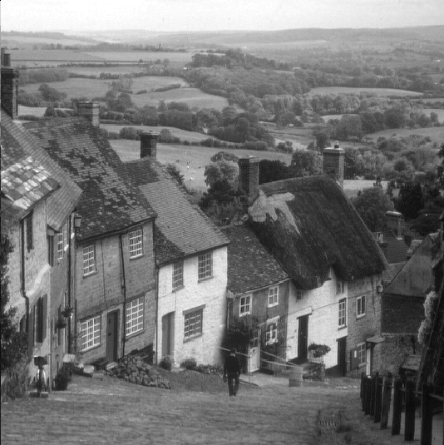
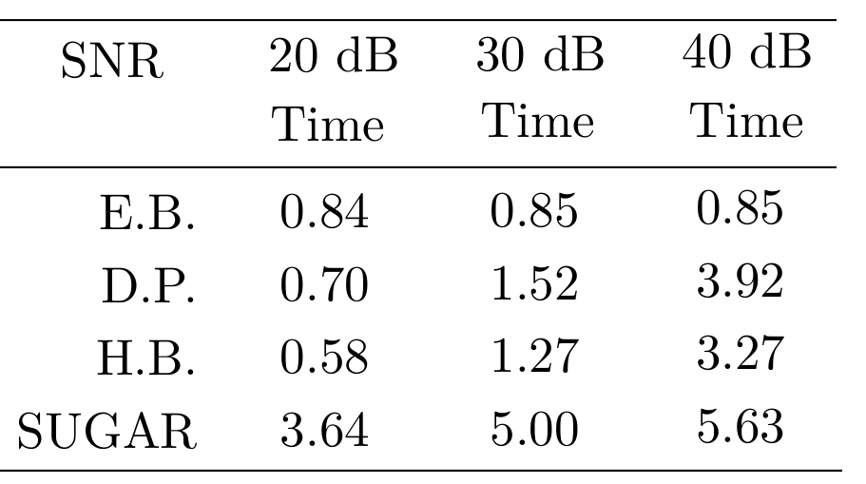
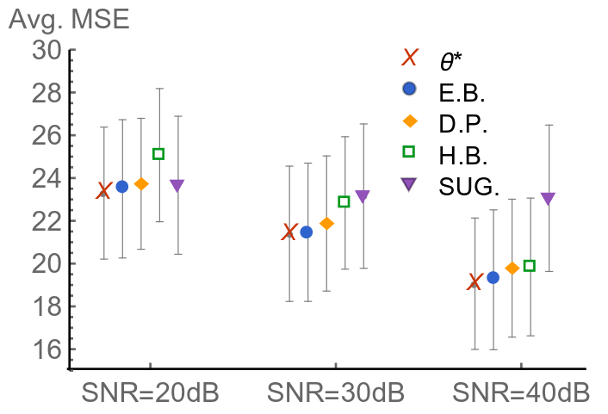
Numerical Experiments
TV non-blind deconvolution
We compute the MAP estimator $→$ average results for 10 test images
minutes
Notes:
Don ‘t take the computing times too seriously

Slide 38
Numerical Experiments
Hyperspectral Unmixing
$$\sim N(0,σ^{2}I)$$
$$y = A x + z$$
$$np=75×75$$
$$224×np$$
$$12×np$$
$$224×12$$
SIGNATURE
DICTIONARY
$$75 pixels$$
$$12 end members \\ (materials)$$
$$75 pixels$$
$$224 freq. bands$$
$$75 pixels$$
$$75 pixels$$
FRACTIONAL
ABUNDANCES
$$y∈ℝ^{224×np=1260000}$$
$$x∈ℝ^{12×np=67500}$$
MEASUREMENTS
Iordache, Marian-Daniel, José M. Bioucas-Dias, and Antonio Plaza. "Total variation spatial regularization for sparse hyperspectral unmixing." IEEE Transactions on Geoscience and Remote Sensing 50, no. 11 (2012): 4484-4502.

Slide 39
Numerical Experiments
Hyperspectral Unmixing
$$y = A x + z$$
$$np=75×75$$
$$224×np$$
$$12×np$$
$$224×12$$
SIGNATURE
DICTIONARY
FRACTIONAL
ABUNDANCES
MEASUREMENTS
$$y∈ℝ^{224×np}$$
$$x∈ℝ^{12×np}$$
Iordache, Marian-Daniel, José M. Bioucas-Dias, and Antonio Plaza. "Total variation spatial regularization for sparse hyperspectral unmixing." IEEE Transactions on Geoscience and Remote Sensing 50, no. 11 (2012): 4484-4502.
Regularisation $→$ $θ_{TV} TV\left(x\right)$ + $θ_{1}{\left\|x\right\|}_{1}^{ } , s.t. x≥0$

Slide 40
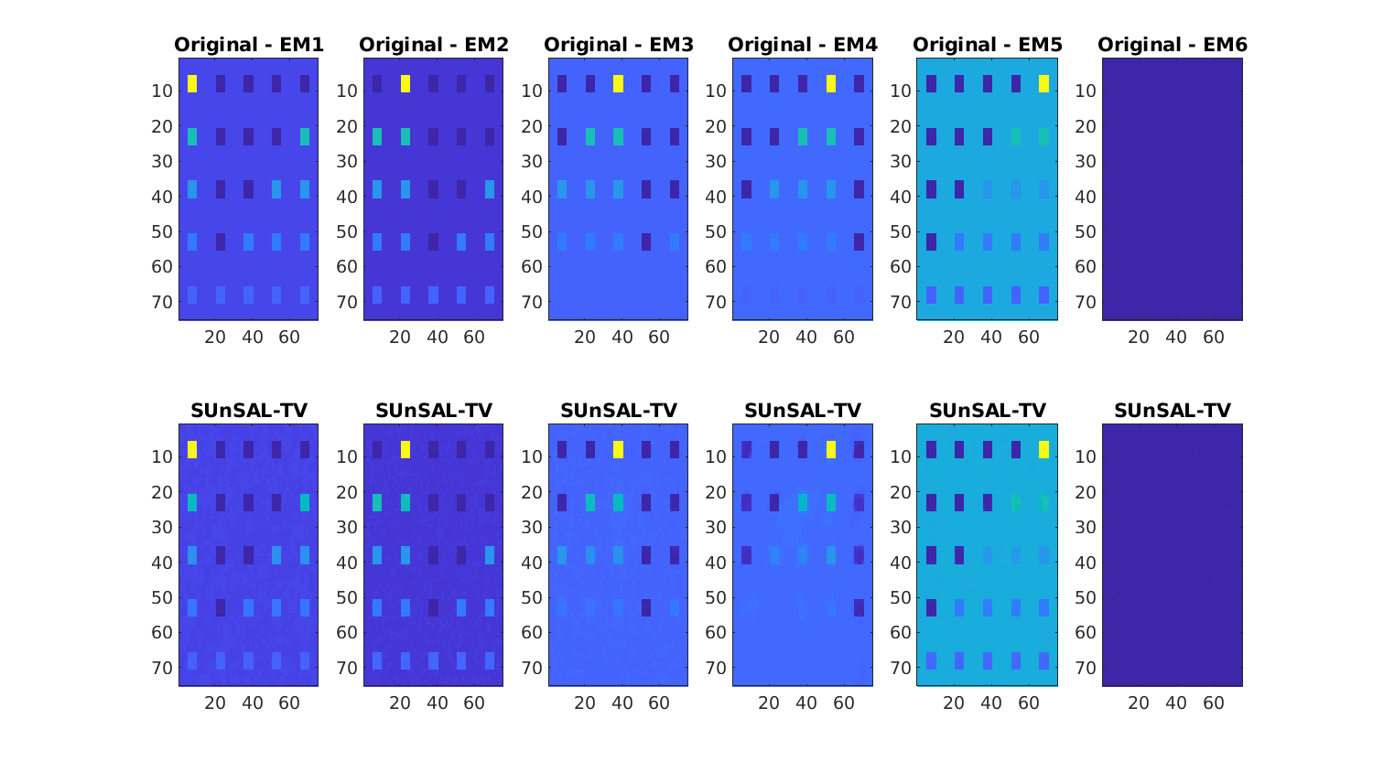
Numerical Experiments
Hyperspectral Unmixing
SNR 20dB

Slide 41
Numerical Experiments
Hyperspectral Unmixing
Signal to reconstruction error (SRE)= $\frac{{\left\|x\right\|}_{2}^{2 }}{{\left\|x−\hat{x}\right\|}_{2}^{2 }}$
Hierarchical Bayes
Empirical Bayes
SNR 20dB
SNR 30dB
SNR 40dB

Slide 42
Numerical Experiments
Hierarchical Bayes
Empirical Bayes
Hyperspectral Unmixing
SNR 20dB
SNR 30dB
SNR 40dB
EB performs well at low SNR values
Achieves close-to-optimal performance
For high SNR values marginalisation is better

Slide 43
Numerical Experiments
TGV denoising
J computes the Jacobian matrixof the image-gradient vector field to its
$∆ = \left(∆^{v} ,∆^{h} \right)$ is the discrete image-gradient
(J∆)(x) is a discrete image-Hessian operator

Slide 44
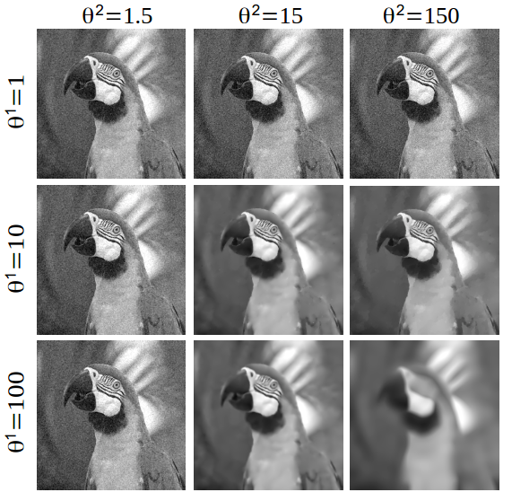
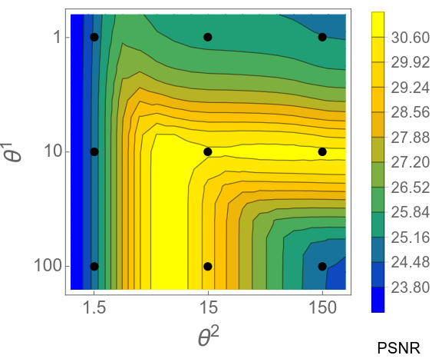
Numerical Experiments
TGV denoising

Slide 45
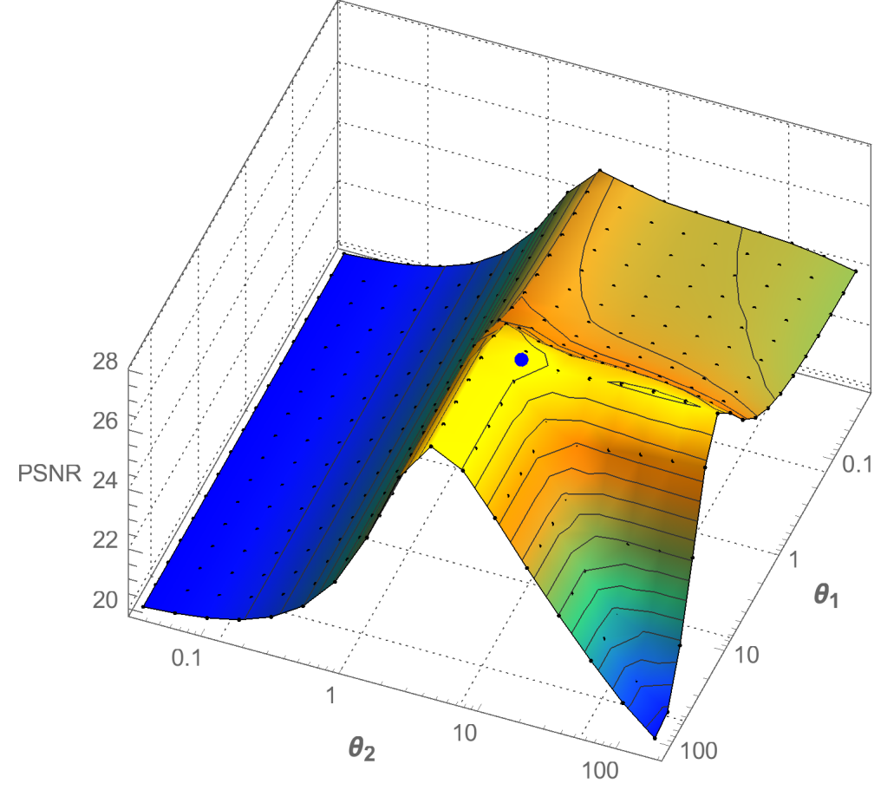
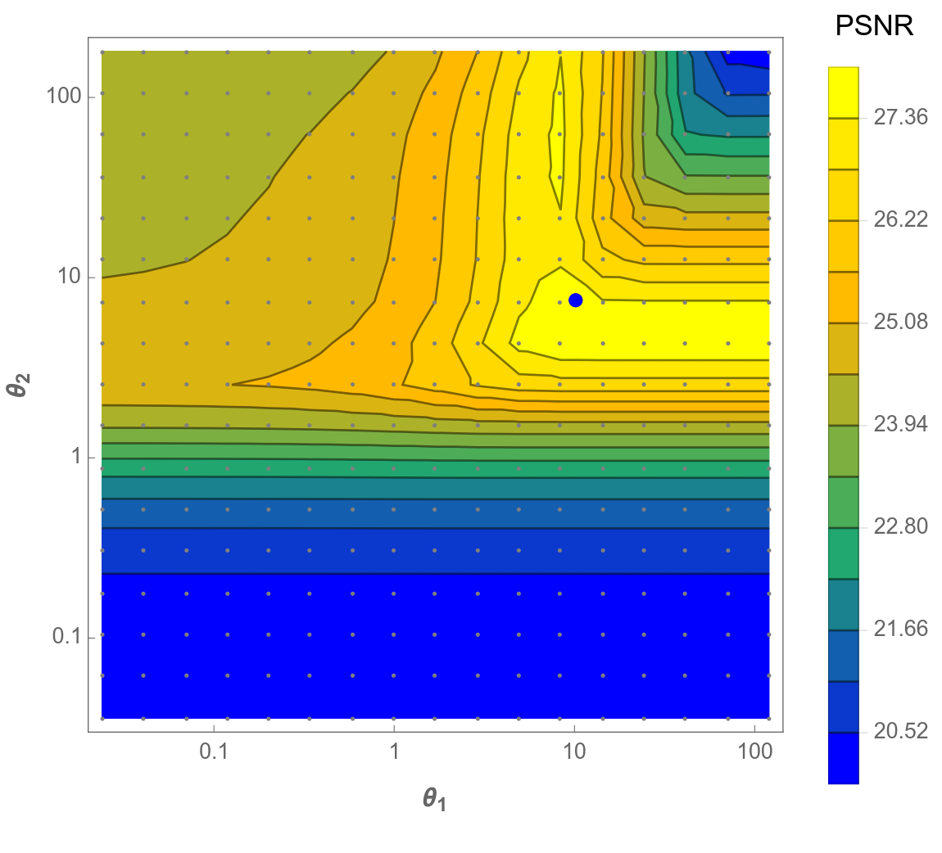
Numerical Experiments
SNR=8dB
Lake image
TGV denoising
PSNR
$$θ_{2}$$
$$θ_{1}$$
$$θ_{1}$$
$$θ_{2}$$

Slide 46
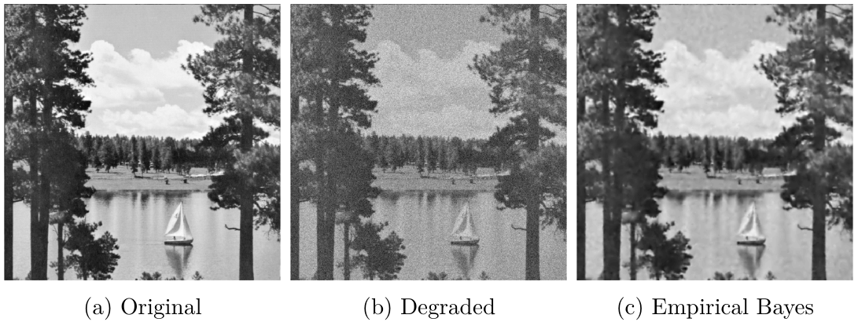
Numerical Experiments
TGV denoising

Slide 47
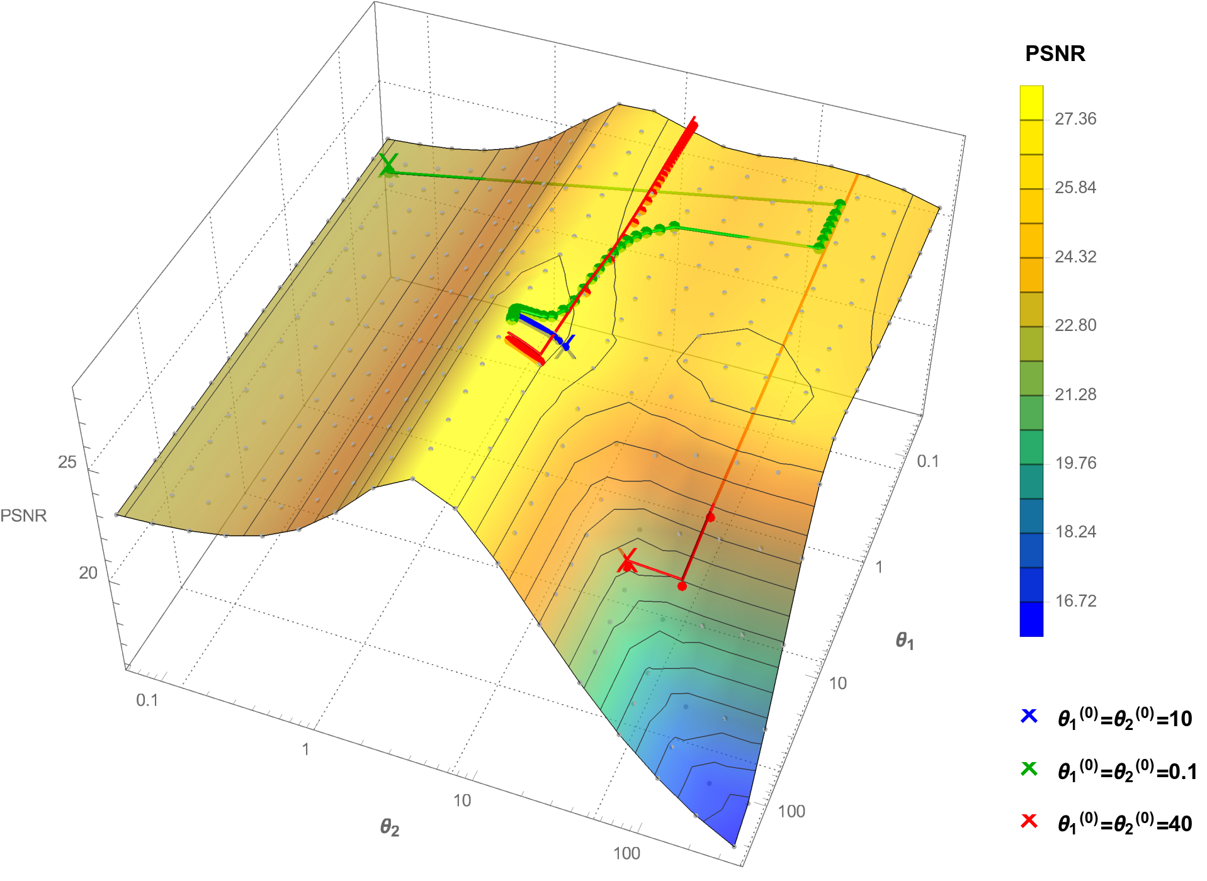
Numerical Experiments
TGV denoising
$$θ_{1}$$
SNR=8dB
Lake image
$$θ_{2}$$

Slide 48
Numerical Experiments
TGV denoising

Slide 49
Practical guidelines
When can I use this method and how? Will it actually work?
Requirements:
Convex problem. Regulariser $φ(x$) can be non-smooth, but needs to be convex.
You need to be able to compute the proximal operator of your regularisers in a reasonable time.
Potential difficulties and limitations:
Operator A is too ill-posed → requires preconditioning
When running 2 Markov chains, use thinning to achieve similar effective sample size
Extremely ill-posed problems→ MYULA Markov kernels might not work
Dimension of $θ$: we tested only 2 parameters. Limits not studied yet.
Performance:
Quality of results limited by quality of model: prior misspecification leads to poor results
Easier to use when running a single Markov chain
Works remarkably well when model is good, even for low SNR scenarios

Slide 50
Conclusions and Future Work
Summary:
$$\log{p(y|θ)}$$
$$∇_{θ}\log{p(y|θ_{ }^{ })}$$
$${\hat{θ_{ }}}_{MLE}$$
$$θ$$
Notes:
We presented an empirical Bayesian method to estimate regularisation parameters in inverse imaging problems.
We solve an intractable maximum likelihood estimation problem by proposing a stochastic optimisation algorithm.
The stochastic approximation is driven by two highly efficient proximal MCMC kernels.
The proposed methodology was illustrated with non-blind image deconvolution with TV prior and hyperspectral unmixing:
it achieved close-to-optimal performance
outperformed other state of the art approaches especially for low SNR
can be used with i) multiple parameters ii) Unknown $C(θ)$(sometimes only option)
longer computing time

Slide 51
Conclusions and Future Work
Summary:
$$\log{p(y|θ)}$$
$$∇_{θ}\log{p(y|θ_{ }^{ })}$$
$=𝔼_{x|θ_{ }}\left[φ\left(x\right) \right]$ $−$ $𝔼_{x|y,θ_{ }}\left[φ\left(x\right) \right]$
$${\hat{θ_{ }}}_{MLE}$$
$$θ$$
Notes:
We presented an empirical Bayesian method to estimate regularisation parameters in inverse imaging problems.
We solve an intractable maximum likelihood estimation problem by proposing a stochastic optimisation algorithm.
The stochastic approximation is driven by two highly efficient proximal MCMC kernels.
The proposed methodology was illustrated with non-blind image deconvolution with TV prior and hyperspectral unmixing:
it achieved close-to-optimal performance
outperformed other state of the art approaches especially for low SNR
can be used with i) multiple parameters ii) Unknown $C(θ)$(sometimes only option)
longer computing time

Slide 52
Conclusions and Future Work
Summary:
$$\log{p(y|θ)}$$
$$∇_{θ}\log{p(y|θ_{ }^{ })}$$
$=𝔼_{x|θ_{ }}\left[φ\left(x\right) \right]$ $−$ $𝔼_{x|y,θ_{ }}\left[φ\left(x\right) \right]$
$$θ$$
PRIOR
POSTERIOR
$${\hat{θ_{ }}}_{MLE}$$
$$[φ\left(U^{t+1}\right)−φ\left(X^{t+1}\right)]$$
Notes:
We presented an empirical Bayesian method to estimate regularisation parameters in inverse imaging problems.
We solve an intractable maximum likelihood estimation problem by proposing a stochastic optimisation algorithm.
The stochastic approximation is driven by two highly efficient proximal MCMC kernels.
The proposed methodology was illustrated with non-blind image deconvolution with TV prior and hyperspectral unmixing:
it achieved close-to-optimal performance
outperformed other state of the art approaches especially for low SNR
can be used with i) multiple parameters ii) Unknown $C(θ)$(sometimes only option)
longer computing time

Slide 53
Conclusions and Future Work
Summary:
$$\log{p(y|θ)}$$
$$∇_{θ}\log{p(y|θ_{ }^{ })}$$
$=𝔼_{x|θ_{ }}\left[φ\left(x\right) \right]$ $−$ $𝔼_{x|y,θ_{ }}\left[φ\left(x\right) \right]$
$$θ$$
PRIOR
POSTERIOR
$${\hat{θ_{ }}}_{MLE}$$
$$[φ\left(U^{t+1}\right)−φ\left(X^{t+1}\right)]$$
MYULA SAMPLER
Notes:
We presented an empirical Bayesian method to estimate regularisation parameters in inverse imaging problems.
We solve an intractable maximum likelihood estimation problem by proposing a stochastic optimisation algorithm.
The stochastic approximation is driven by two highly efficient proximal MCMC kernels.
The proposed methodology was illustrated with non-blind image deconvolution with TV prior and hyperspectral unmixing:
it achieved close-to-optimal performance
outperformed other state of the art approaches especially for low SNR
can be used with i) multiple parameters ii) Unknown $C(θ)$(sometimes only option)
longer computing time

Slide 54
Conclusions and Future Work
Summary:
$$\log{p(y|θ)}$$
$$∇_{θ}\log{p(y|θ_{ }^{ })}$$
$=𝔼_{x|θ_{ }}\left[φ\left(x\right) \right]$ $−$ $𝔼_{x|y,θ_{ }}\left[φ\left(x\right) \right]$
$$θ$$
PRIOR
POSTERIOR
$${\hat{θ_{ }}}_{MLE}$$
$$[φ\left(U^{t+1}\right)−φ\left(X^{t+1}\right)]$$
$φ\left(x\right)$convex, non-smooth
high-dimensions
MYULA SAMPLER
easy implementation
Just need gradients &
proximal operators
Notes:
We presented an empirical Bayesian method to estimate regularisation parameters in inverse imaging problems.
We solve an intractable maximum likelihood estimation problem by proposing a stochastic optimisation algorithm.
The stochastic approximation is driven by two highly efficient proximal MCMC kernels.
The proposed methodology was illustrated with non-blind image deconvolution with TV prior and hyperspectral unmixing:
it achieved close-to-optimal performance
outperformed other state of the art approaches especially for low SNR
can be used with i) multiple parameters ii) Unknown $C(θ)$(sometimes only option)
longer computing time

Slide 55
Conclusions and Future Work
Summary:
$$\log{p(y|θ)}$$
PRIOR
POSTERIOR
$$∇_{θ}\log{p(y|{θ^{t}}_{ }^{ })}$$
$$[φ\left(U^{t+1}\right)−φ\left(X^{t+1}\right)]$$
$$≈$$
$${\hat{θ_{ }}}_{MLE}$$
$$θ$$
EB performs remarkably well at low SNR values
Generally outperforms many other approaches
Can handle multiple regularisation parameters
Achieves close-to-optimal performance
Fast
In some problems setting up the sampler can be difficult
Although it handles very high dimensions, for extremely ill-posed and high dimensional problems it can be slow.
Notes:
We presented an empirical Bayesian method to estimate regularisation parameters in inverse imaging problems.
We solve an intractable maximum likelihood estimation problem by proposing a stochastic optimisation algorithm.
The stochastic approximation is driven by two highly efficient proximal MCMC kernels.
The proposed methodology was illustrated with non-blind image deconvolution with TV prior and hyperspectral unmixing:
it achieved close-to-optimal performance
outperformed other state of the art approaches especially for low SNR
can be used with i) multiple parameters ii) Unknown $C(θ)$(sometimes only option)
longer computing time

Slide 56
Conclusions and Future Work
Summary:
$$\log{p(y|θ)}$$
PRIOR
POSTERIOR
$$∇_{θ}\log{p(y|{θ^{t}}_{ }^{ })}$$
$$[φ\left(U^{t+1}\right)−φ\left(X^{t+1}\right)]$$
$$≈$$
$${\hat{θ_{ }}}_{MLE}$$
$$θ$$
Future Work:
- Accelerate the Markov kernels driving the stochastic approximation algorithm.
EB performs remarkably well at low SNR values
Generally outperforms many other approaches
Can handle multiple regularisation parameters
Achieves close-to-optimal performance
Fast
In some problems setting up the sampler can be difficult
Although it handles very high dimensions, for extremely ill-posed and high dimensional problems it can be slow.
Notes:
We presented an empirical Bayesian method to estimate regularisation parameters in inverse imaging problems.
We solve an intractable maximum likelihood estimation problem by proposing a stochastic optimisation algorithm.
The stochastic approximation is driven by two highly efficient proximal MCMC kernels.
The proposed methodology was illustrated with non-blind image deconvolution with TV prior and hyperspectral unmixing:
it achieved close-to-optimal performance
outperformed other state of the art approaches especially for low SNR
can be used with i) multiple parameters ii) Unknown $C(θ)$(sometimes only option)
longer computing time

Slide 57
References
[1] Vidal, A. F., De Bortoli, V., Pereyra, M., & Durmus, A. Maximum likelihood estimation of regularisation parameters in high-dimensional inverse problems: an empirical Bayesian approach, (2019).
arXiv preprint arXiv:1911.11709.
MLE OF REGULARISATION PARAMETERS. PROOFS OF CONVERGENCE
[2] De Bortoli, V., Durmus, A., Pereyra, M., & Vidal, A. F. Efficient stochastic optimisation by unadjusted Langevin Monte Carlo. Application to maximum marginal likelihood and empirical Bayesian Estimation, (2019).
arXiv preprint arXiv:1906.12281.
EMPIRICAL BAYES ALGO. FOR GENERAL SMOOTH PROBLEMS. PROOFS OF CONVERGENCE
[3] Alain Durmus, Eric Moulines, and Marcelo Pereyra, “Efficient Bayesian computation by proximal Markov Chain Monte Carlo: when Langevin meets Moreau,” SIAM Journal on Imaging Sciences, vol. 11, no. 1, pp. 473–506, 2018.
MYULA ALGORITHM
[4] Ana Fernandez Vidal and Marcelo Pereyra. "Maximum Likelihood Estimation of Regularisation Parameters." In 2018 25th IEEE International Conference on Image Processing (ICIP), pp. 1742-1746. IEEE, 2018. EMPIRICAL BAYES ALGORITHM

Slide 58
Thank you for your time!
Questions?

