Slide 1
Maximum likelihood estimation of regularisation parameters: an empirical Bayesian approach
Ana Fernández Vidal
Marcelo Pereyra
Valentin De Bortoli
Alain Durmus
School of Mathematical and Computer Sciences, Heriot-Watt University
École normale supérieure Paris-Saclay,
CNRS, Université Paris-Saclay
2nd IMA Conference On Inverse Problems From Theory To Application University College London - September 2019

Slide 2
High-dimensional Inverse Problems
We want to recover $x$ from the observation $y$
NOISE
UNKNOWN
IMAGE
LINEAR
OPERATOR
$$w\sim N(0,σ^{2}I)$$
OBSERVATION
A
+
$y=Ax+w$
$$x∈ℝ^{n}$$
- rank deficient
- small eigenvalues
$$y∈ℝ^{m}$$
We measure $y$, related to $x$ by a statistical model $p\left(y | x\right):$
PROBLEM: The recovery of $x$from $y$ is ill-posed or ill-conditioned, resulting in significant uncertainty about $x$.
$$p\left(y | x\right)∝e^{− \frac{{\left\|y−Ax\right\|}_{2}^{2}}{2σ^{2}}}$$
LIKELIHOOD
DATA FIDELITY

Slide 3
The Bayesian Framework
We use priors to reduce uncertainty and deliver accurate estimates.
HYPERPARAMETER
REGULARISER
$$p\left(x|θ\right)=\frac{e^{−θ φ\left(x\right)}}{Z(θ)}$$
$We will assume that φ\left(x\right)$ is
-convex
-possibly non-smooth
PRIOR DISTRIBUTION

Slide 4
The Bayesian Framework
We obtain the posterior using Bayes’ rule.
HYPERPARAMETER
REGULARISER
$$p\left(x|θ\right)=\frac{e^{−θ φ\left(x\right)}}{Z(θ)}$$
$$p\left(y | x\right)∝e^{− \frac{{\left\|y−Ax\right\|}_{2}^{2}}{2σ^{2}}}$$
LIKELIHOOD
DATA FIDELITY
PRIOR DISTRIBUTION
BAYES’ RULE
POSTERIOR
$p\left(x | y,θ\right)=\frac{p\left(y|x\right)p\left(x|θ\right)}{p(y|θ)}$ $\text{∝}$ $e^{−\frac{{\left\|y−Ax\right\|}_{2}^{2}}{2σ^{2}}− θ φ(x)}$
LOG-CONCAVE

Slide 5
Bayesian Formulation of the problem
$p\left(x | y,θ\right)$ $\text{∝}$ $e^{−\frac{{\left\|y−Ax\right\|}_{2}^{2}}{2σ^{2}}− θ φ(x)}$
POSTERIOR
The predominant Bayesian approach in imaging is MAP estimation which can be computed very eﬃciently by convex optimisation:
$${\hat{x}}_{MAP} _{ }=\underset{x∈ℝ^{n}}{argmax}{p\left(x | y,θ\right)}$$
CONVEX
$${\hat{x}}_{MAP} _{ }=\underset{x∈ℝ^{n}}{argmin}{\frac{{\left\|y−Ax\right\|}_{2}^{2}}{2σ^{2}}+ θ φ(x)}$$

Slide 6
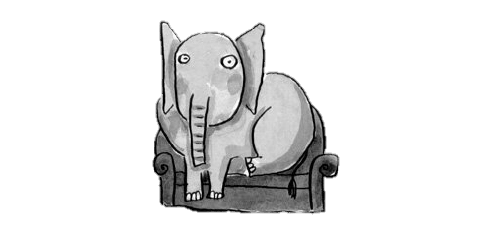
Bayesian Formulation of the problem
How do we choose the regularisation parameter?
$${\hat{x}}_{MAP} _{ }=\underset{x∈ℝ^{n}}{argmin}{\frac{{\left\|y−Ax\right\|}_{2}^{2}}{2σ^{2}}+ θ φ(x)}$$
Notes:
3.50

Slide 7
Choosing the regularisation parameter
Non-Bayesian approaches
Cross-validation (exhaustive-search)
Discrepancy principles and L-curves
Stein-based methods (SURE)
SUGAR (computes gradient of SURE, solver dependent)
Bayesian approaches
Hierarchical: propose prior for $θ$.
Marginalisation $p(x|y)= \int_{ℝ^{+}}^{ }{p\left(x,θ | y\right)dθ}$
Joint MAP estimation $\left(\hat{x},\hat{θ}\right)$
Empirical Bayes
Choose $θ$ by maximizing marginal likelihood
$${\left\|y−A {\hat{x}}_{MAP}(θ) _{ }\right\|}_{2}^{2}$$
Notes:
3.36

Slide 8
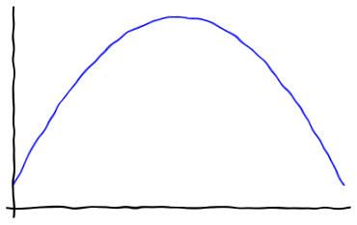
Empirical Bayes
We want to find ${\hat{θ}}_{ }$that maximizes the marginal likelihood $p(y|θ)$:
$p\left(y | θ\right)=\int_{ℝ^{n}}^{ }{p\left(y,x | θ\right)dx}=\int_{ℝ^{n}}^{ }{p\left(y | x\right) p\left(x | θ\right)dx}$
$$\log{p(y|θ)}$$
EMPIRICAL BAYES
POSTERIOR
$$p\left(x | y,{\hat{θ_{ }}}_{MLE}\right)$$
$$θ$$
$${\hat{θ_{ }}}_{MLE}$$
Notes:
6.50

Slide 9
Empirical Bayes
We want to find $\hat{θ}$ that maximizes the marginal likelihood $p(y|θ)$:
$p(y|θ)= \int_{ℝ^{n}}^{ }{p\left(y | x\right) p\left(x | θ\right)dx}$
$$\log{p(y|θ)}$$
$$θ$$
$${\hat{θ_{ }}}_{MLE}$$
$$θ^{t}$$

Slide 10
Empirical Bayes
We want to find $\hat{θ}$ that maximizes the marginal likelihood $p(y|θ)$:
$p(y|θ)= \int_{ℝ^{n}}^{ }{p\left(y | x\right) p\left(x | θ\right)dx}$
$$\log{p(y|θ)}$$
$$θ$$
$${\hat{θ_{ }}}_{MLE}$$
$$θ^{t+1}$$
$$θ^{t}$$
$$∇_{θ}\log{p(y|θ_{ }^{t})}$$

Slide 11
Empirical Bayes
We want to find $\hat{θ}$ that maximizes the marginal likelihood $p(y|θ)$:
$p(y|θ)= \int_{ℝ^{n}}^{ }{p\left(y | x\right) p\left(x | θ\right)dx}$
$$\log{p(y|θ)}$$
PROJECTED GRADIENT ALGORITHM
$θ_{ }^{t+1}=𝒫_{Θ}[θ_{ }^{t}+δ_{t}∇_{θ}\log{p(y|θ_{ }^{t})}$]
$$θ$$
$${\hat{θ_{ }}}_{MLE}$$
$$θ^{t+1}$$
$$θ^{t}$$
$$∇_{θ}\log{p(y|θ_{ }^{t})}$$

Slide 12
Empirical Bayes
We want to find $\hat{θ}$ that maximizes the marginal likelihood $p(y|θ)$:
$p(y|θ)= \int_{ℝ^{n}}^{ }{p\left(y | x\right) p\left(x | θ\right)dx}$
$$\frac{e^{−θ φ\left(x\right)}}{Z(θ)}$$
$$\log{p(y|θ)}$$
PROJECTED GRADIENT ALGORITHM
$θ_{ }^{t+1}=𝒫_{Θ}[θ_{ }^{t}+δ_{t}∇_{θ}\log{p(y|θ_{ }^{t})}$]
$$θ$$
$${\hat{θ_{ }}}_{MLE}$$
$$θ^{t+1}$$
$$θ^{t}$$
$$∇_{θ}\log{p(y|θ_{ }^{t})}$$

Slide 13
Empirical Bayes
We want to find $\hat{θ}$ that maximizes the marginal likelihood $p(y|θ)$:
$p(y|θ)= \int_{ℝ^{n}}^{ }{p\left(y | x\right) p\left(x | θ\right)dx}$
$$\frac{e^{−θ φ\left(x\right)}}{Z(θ)}$$
$$\log{p(y|θ)}$$
PROJECTED GRADIENT ALGORITHM
$θ_{ }^{t+1}=𝒫_{Θ}[θ_{ }^{t}+δ_{t}∇_{θ}\log{p(y|θ_{ }^{t})}$]
$$θ$$
$${\hat{θ_{ }}}_{MLE}$$
$$θ^{t+1}$$
$$θ^{t}$$
$$∇_{θ}\log{p(y|θ_{ }^{t})}$$
We developed an efficient stochastic optimization scheme for computing ${\hat{θ_{ }}}_{MLE}$

Slide 14
Empirical Bayes
PROJECTED GRADIENT ALGORITHM
$θ_{ }^{t+1}=𝒫_{Θ}[θ_{ }^{t}+δ_{t}∇_{θ}\log{p(y|θ_{ }^{t})})$]

Slide 15
Empirical Bayes
PROJECTED GRADIENT ALGORITHM
$θ_{ }^{t+1}=𝒫_{Θ}[θ_{ }^{t}+δ_{t}∇_{θ}\log{p(y|θ_{ }^{t})})$]
Fisher’s identity
$$∇_{θ}\log{p\left(y | θ_{ }^{ }\right)}=𝔼_{x|y,θ_{ }}\left[∇_{θ}\log{ p\left(x,y | θ_{ }^{ }\right)}\right]$$
$${∇_{θ}\log{p(y|θ_{ }^{ })}=𝔼}_{x|y,θ_{ }}\left[∇_{θ}\log{ p\left(x,y | θ_{ }^{ }\right)}\right]$$
Notes:
7.22

Slide 16
Empirical Bayes
PROJECTED GRADIENT ALGORITHM
$θ_{ }^{t+1}=𝒫_{Θ}[θ_{ }^{t}+δ_{t}∇_{θ}\log{p(y|θ_{ }^{t})})$]
Fisher’s identity
$$∇_{θ}\log{p\left(y | θ_{ }^{ }\right)}=𝔼_{x|y,θ_{ }}\left[∇_{θ}\log{ p\left(x,y | θ_{ }^{ }\right)}\right]$$
$${∇_{θ}\log{p(y|θ_{ }^{ })}=𝔼}_{x|y,θ_{ }}\left[−φ\left(x\right) \right]−∇_{θ}\log{Z\left(θ\right)}$$

Slide 17
Empirical Bayes
PROJECTED GRADIENT ALGORITHM
$θ_{ }^{t+1}=𝒫_{Θ}[θ_{ }^{t}+δ_{t}∇_{θ}\log{p(y|θ_{ }^{t})})$]
Fisher’s identity
$$∇_{θ}\log{p\left(y | θ_{ }^{ }\right)}=𝔼_{x|y,θ_{ }}\left[∇_{θ}\log{ p\left(x,y | θ_{ }^{ }\right)}\right]$$
$${∇_{θ}\log{p(y|θ_{ }^{ })}=𝔼}_{x|y,θ_{ }}\left[−φ\left(x\right) \right]−∇_{θ}\log{Z\left(θ\right)}$$
We can approximate $𝔼_{x|y,θ_{ }}$ with Monte Carlo estimate

Slide 18
Empirical Bayes
PROJECTED GRADIENT ALGORITHM
$θ_{ }^{t+1}=𝒫_{Θ}[θ_{ }^{t}+δ_{t}∇_{θ}\log{p(y|θ_{ }^{t})})$]
$$p\left(x|θ\right)=\frac{e^{−θ φ\left(x\right)}}{Z(θ)}$$
Fisher’s identity
$$∇_{θ}\log{p\left(y | θ_{ }^{ }\right)}=𝔼_{x|y,θ_{ }}\left[∇_{θ}\log{ p\left(x,y | θ_{ }^{ }\right)}\right]$$
PRIOR DISTRIBUTION
$${∇_{θ}\log{p(y|θ_{ }^{ })}=𝔼}_{x|y,θ_{ }}\left[−φ\left(x\right) \right]−∇_{θ}\log{Z\left(θ\right)}$$

Slide 19
Empirical Bayes
PROJECTED GRADIENT ALGORITHM
$θ_{ }^{t+1}=𝒫_{Θ}[θ_{ }^{t}+δ_{t}∇_{θ}\log{p(y|θ_{ }^{t})})$]
Fisher’s identity
$$∇_{θ}\log{p\left(y | θ_{ }^{ }\right)}=𝔼_{x|y,θ_{ }}\left[∇_{θ}\log{ p\left(x,y | θ_{ }^{ }\right)}\right]$$
$${∇_{θ}\log{p(y|θ_{ }^{ })}=𝔼}_{x|y,θ_{ }}\left[−φ\left(x\right) \right]−∇_{θ}\log{Z\left(θ\right)}$$
$$−\frac{d}{dθ_{ }}\log{Z\left(θ\right)}=\frac{n}{k θ}$$
$φ\left(x\right)$ k-homogeneous
Scalar $θ$

Slide 20
Empirical Bayes
PROJECTED GRADIENT ALGORITHM
$θ_{ }^{t+1}=𝒫_{Θ}[θ_{ }^{t}+δ_{t}∇_{θ}\log{p(y|θ_{ }^{t})})$]
Fisher’s identity
$$∇_{θ}\log{p\left(y | θ_{ }^{ }\right)}=𝔼_{x|y,θ_{ }}\left[∇_{θ}\log{ p\left(x,y | θ_{ }^{ }\right)}\right]$$
$${∇_{θ}\log{p(y|θ_{ }^{ })}=𝔼}_{x|y,θ_{ }}\left[−φ\left(x\right) \right]−∇_{θ}\log{Z\left(θ\right)}$$
${−∇}_{θ}\log{Z\left(θ\right)}$= $𝔼_{x|θ_{ }}[φ\left(x\right)]$
$$∇_{θ}\log{p(y|θ_{ }^{ })}=𝔼_{x|y,θ_{ }}\left[−φ\left(x\right) \right]+𝔼_{x|θ_{ }}\left[φ\left(x\right) \right]$$

Slide 21
Empirical Bayes
PROJECTED GRADIENT ALGORITHM
$θ_{ }^{t+1}=𝒫_{Θ}[θ_{ }^{t}+δ_{t}∇_{θ}\log{p(y|θ_{ }^{t})})$]
$∇_{θ}\log{p(y|θ_{ }^{ })}=𝔼_{x|θ_{ }}\left[φ\left(x\right) \right]$ $−$ $𝔼_{x|y,θ_{ }}\left[φ\left(x\right) \right]$
We can approximate $𝔼_{x|y,θ_{ }}$ and $𝔼_{x|θ_{ }}$with Monte Carlo estimate

Slide 22
Empirical Bayes
STOCHASTIC APPROXIMATION PROXIMAL GRADIENT ALGORITHM (SAPG)
$$X^{t+1}\sim M_{θ^{t}}^{ }\left(X | y,θ_{ }^{t}, X^{t}\right)$$
POSTERIOR
$𝔼_{x|θ_{ }}\left[φ\left(x\right) \right]$ $−$ $𝔼_{x|y,θ_{ }}\left[φ\left(x\right) \right]$
$$U^{t+1}\sim K_{θ^{t}}^{ }\left(U | θ_{ }^{t}, U^{t}\right)$$
PRIOR
$θ_{ }^{t+1}=𝒫_{Θ}[θ_{ }^{t}+δ_{t}(φ\left(U^{t+1}\right)−φ\left(X^{t+1}\right))$]
We approximate each expectation with only one Montecarlo sample.
Notes:
NON HOMOGENEOUS KERNEL

Slide 23
Empirical Bayes
STOCHASTIC APPROXIMATION PROXIMAL GRADIENT ALGORITHM (SAPG)
$$X^{t+1}\sim M_{θ^{t}}^{ }\left(X | y,θ_{ }^{t}, X^{t}\right)$$
$$p\left(x | y,{\hat{θ_{ }}}_{MLE}\right)$$
POSTERIOR
$$U^{t+1}\sim K_{θ^{t}}^{ }\left(U | θ_{ }^{t}, U^{t}\right)$$
PRIOR
$$p\left(x | {\hat{θ_{ }}}_{MLE}\right)$$
$${\hat{θ_{ }}}_{MLE}$$
$θ_{ }^{t+1}=𝒫_{Θ}[θ_{ }^{t}+δ_{t}(φ\left(U^{t+1}\right)−φ\left(X^{t+1}\right))$]
arXiv:1906.12281v1 [stat.CO] 28 Jun 2019

Slide 24
Empirical Bayes
$$\log{p(y|θ)}$$
$$for{ θ={\hat{θ_{ }}}_{MLE} }_{ }$$
$𝔼_{x|θ_{ }}\left[φ\left(x\right) \right]$ $=$ $𝔼_{x|y,θ_{ }}\left[φ\left(x\right) \right]$
$$θ$$
$${\hat{θ_{ }}}_{MLE}$$

Slide 25
How to generate the samples
$$X^{t+1}\sim M_{θ^{t}}^{ }\left(X | y,θ_{ }^{t}, X^{t}\right)$$
POSTERIOR
$$U^{t+1}\sim K_{θ^{t}}^{ }\left(U | θ_{ }^{t}, U^{t}\right)$$
PRIOR
UNADJUSTED LANGEVIN ALGORITHM (ULA)
$$W^{t+1}\sim N\left(0, 𝕀 \right)$$
$$M_{θ^{ }}^{ }: x^{t+1}=x^{t}+γ ∇_{x}\log{p\left(x^{t} | y,θ\right)}+\sqrt{2γ} W^{t+1}$$
$$^{−\frac{{\left\|y−Ax\right\|}_{2}^{2}}{2σ^{2}}− θ φ(x)}$$
$φ$ may be non-differentiable

Slide 26
How to generate the samples
$$X^{t+1}\sim M_{θ^{t}}^{ }\left(X | y,θ_{ }^{t}, X^{t}\right)$$
POSTERIOR
$$U^{t+1}\sim K_{θ^{t}}^{ }\left(U | θ_{ }^{t}, U^{t}\right)$$
PRIOR
UNADJUSTED LANGEVIN ALGORITHM (ULA)
$$W^{t+1}\sim N\left(0, 𝕀 \right)$$
$$M_{θ^{ }}^{ }: x^{t+1}=x^{t}+γ{ ∇}_{x}\log{p\left(x^{t} | y,θ\right)}+\sqrt{2γ} W^{t+1}$$
$$^{−\frac{{\left\|y−Ax\right\|}_{2}^{2}}{2σ^{2}}− θ φ(x)}$$
$${\tilde{φ}}_{λ}(x)$$
Moreau Envelope

Slide 27
How to generate the samples
How to generate the samples
$$X^{t+1}\sim M_{θ^{t}}^{ }\left(X | y,θ_{ }^{t}, X^{t}\right)$$
POSTERIOR
$$U^{t+1}\sim K_{θ^{t}}^{ }\left(U | θ_{ }^{t}, U^{t}\right)$$
PRIOR
MOREAU-YOSIDA UNADJUSTED LANGEVIN ALGORITHM (MYULA)
$$M_{θ^{ }}^{ }:{ X}^{t+1}=X^{t}−γ_{x} \left( \frac{A^{T}\left(AX^{t}−y\right)}{σ^{2}} + \frac{X^{t}−prox_{φ}^{λθ}\left(X^{t}\right)}{λ} \right)+\sqrt{2γ_{x}} W^{t+1}$$
$$W^{t+1}\sim N\left(0, 𝕀 \right)$$
$${∇_{x}\tilde{φ}}_{λ}(x)$$
$$∇_{x}$$
$$\frac{{\left\|y−AX^{t}\right\|}_{2}^{2}}{2σ^{2}}$$
27

Slide 28
How to generate the samples
How to generate the samples
$$X^{t+1}\sim M_{θ^{t}}^{ }\left(X | y,θ_{ }^{t}, X^{t}\right)$$
POSTERIOR
$$U^{t+1}\sim K_{θ^{t}}^{ }\left(U | θ_{ }^{t}, U^{t}\right)$$
PRIOR
MOREAU-YOSIDA UNADJUSTED LANGEVIN ALGORITHM (MYULA)
$$M_{θ^{ }}^{ }: X^{t+1}=X^{t}−γ_{x} \left( \frac{A^{T}\left(AX^{t}−y\right)}{σ^{2}} + \frac{X^{t}−prox_{φ}^{λθ}\left(X^{t}\right)}{λ} \right)+\sqrt{2γ_{x}} W^{t+1}$$
$$K_{θ^{ }}^{ }: U^{t+1}=U^{t}−γ_{u} \left( \frac{U^{t}−prox_{φ}^{λθ}\left(U^{t}\right)}{λ} \right)+\sqrt{2γ_{u}} W^{t+1}$$
arXiv:1612.07471v1 [stat.CO]
28
Notes:
MYULA
high-dimensionality
convex problems that are not smooth.

Slide 29
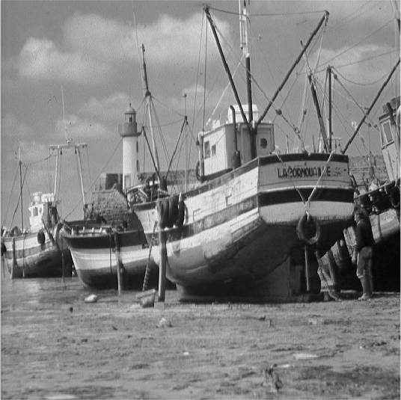
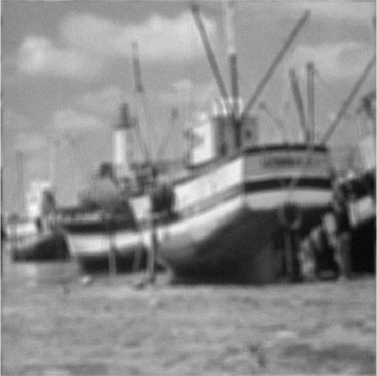
Numerical Experiments
TV non-blind deconvolution
NOISE
SNR=20dB
$$w\sim N(0,σ^{2}I)$$
uniform blur 9x9 pixels
+
$$512×512$$
$$512×512$$
$$x∈ℝ^{262144}$$
$$y∈ℝ^{262144}$$
Regularisation $→$ $φ\left(x\right)=TV\left(x\right)$
$$−\frac{d}{dθ_{ }}\log{Z\left(θ\right)}=\frac{n}{k θ}$$
$$X^{t+1}\sim M_{θ^{t}}^{ }\left(X | y,θ_{ }^{t}, X^{t}\right)$$
POSTERIOR
$${∇_{θ}\log{p(y|θ_{ }^{ })}≈}_{ }\frac{n}{θ}−φ\left(X^{t+1}\right)$$
$φ\left(x\right)$ k-homogeneous
Scalar $θ$

Slide 30
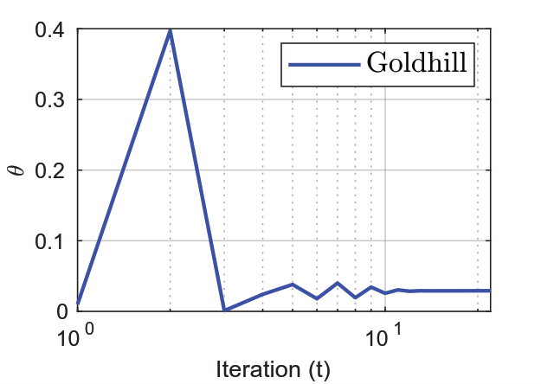
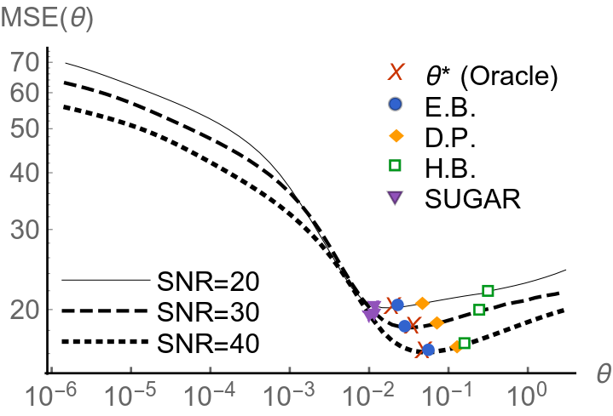
Numerical Experiments
TV non-blind deconvolution

Slide 31
Numerical Experiments
TV non-blind deconvolution
Discrepancy: Morozov 1984
SUGAR: arXiv:1405.1164v2
Hierarchical Bayes: Pereyra,
Bioucas-Dias & Figueiredo 2015

Slide 32
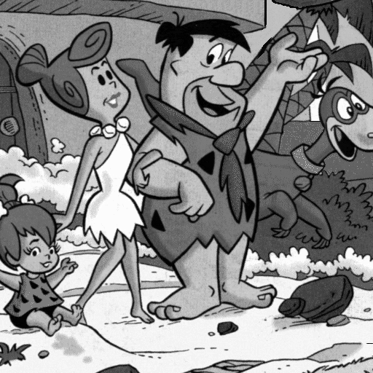
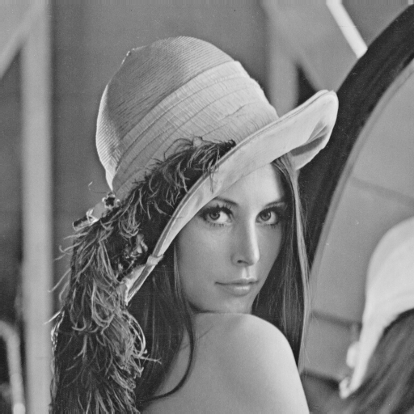
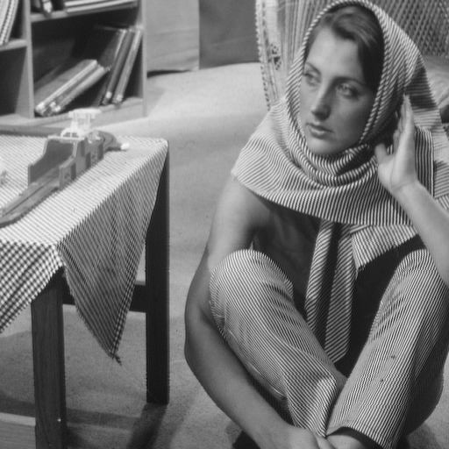
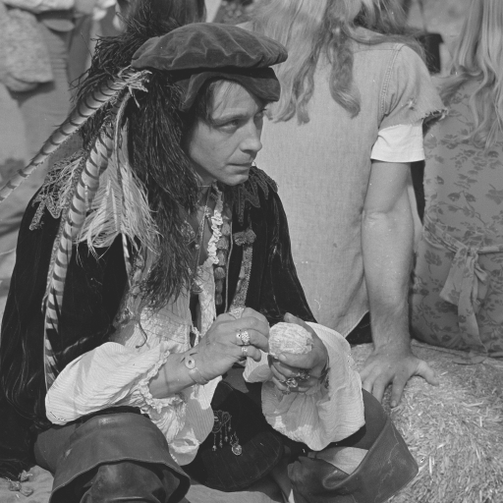
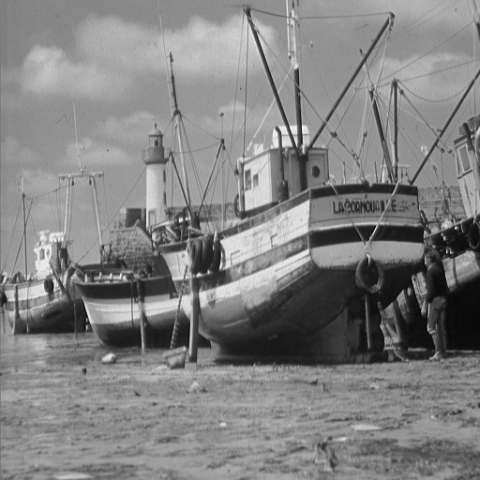
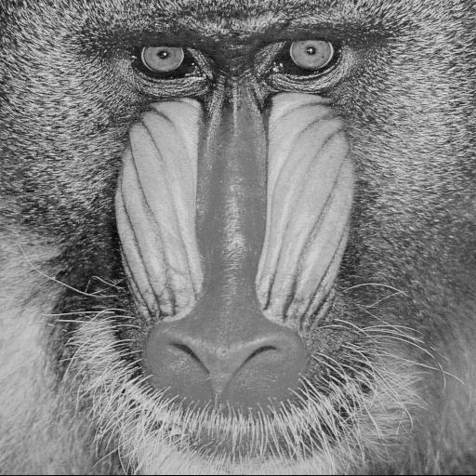
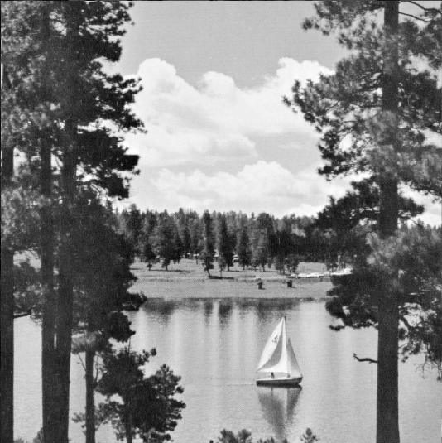
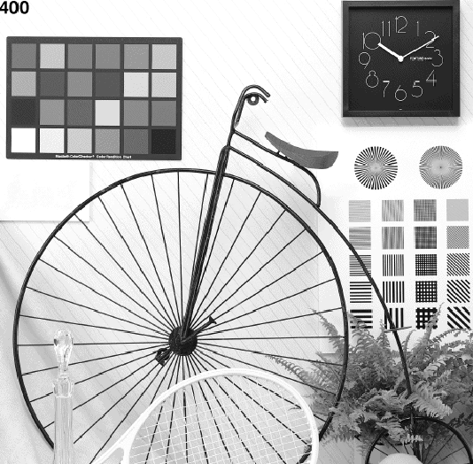
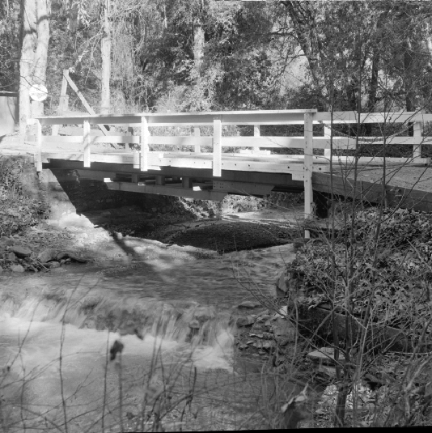
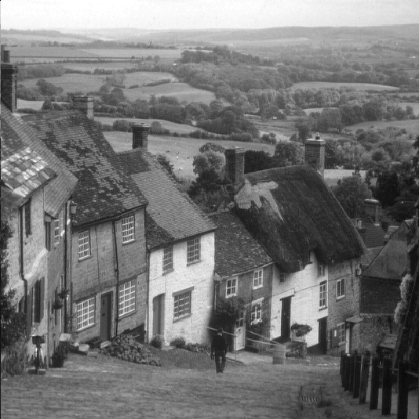
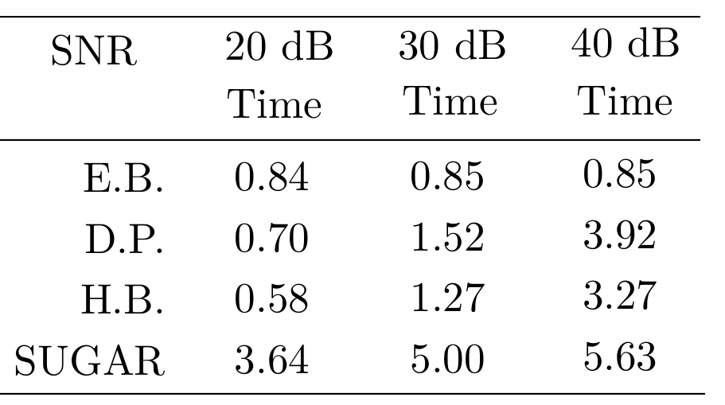
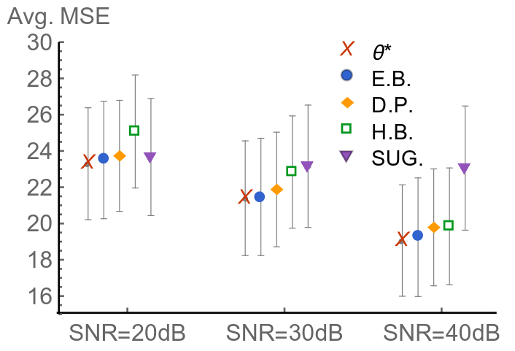
Numerical Experiments
TV non-blind deconvolution
We compute the MAP estimator $→$ average results for 10 test images
minutes

Slide 33
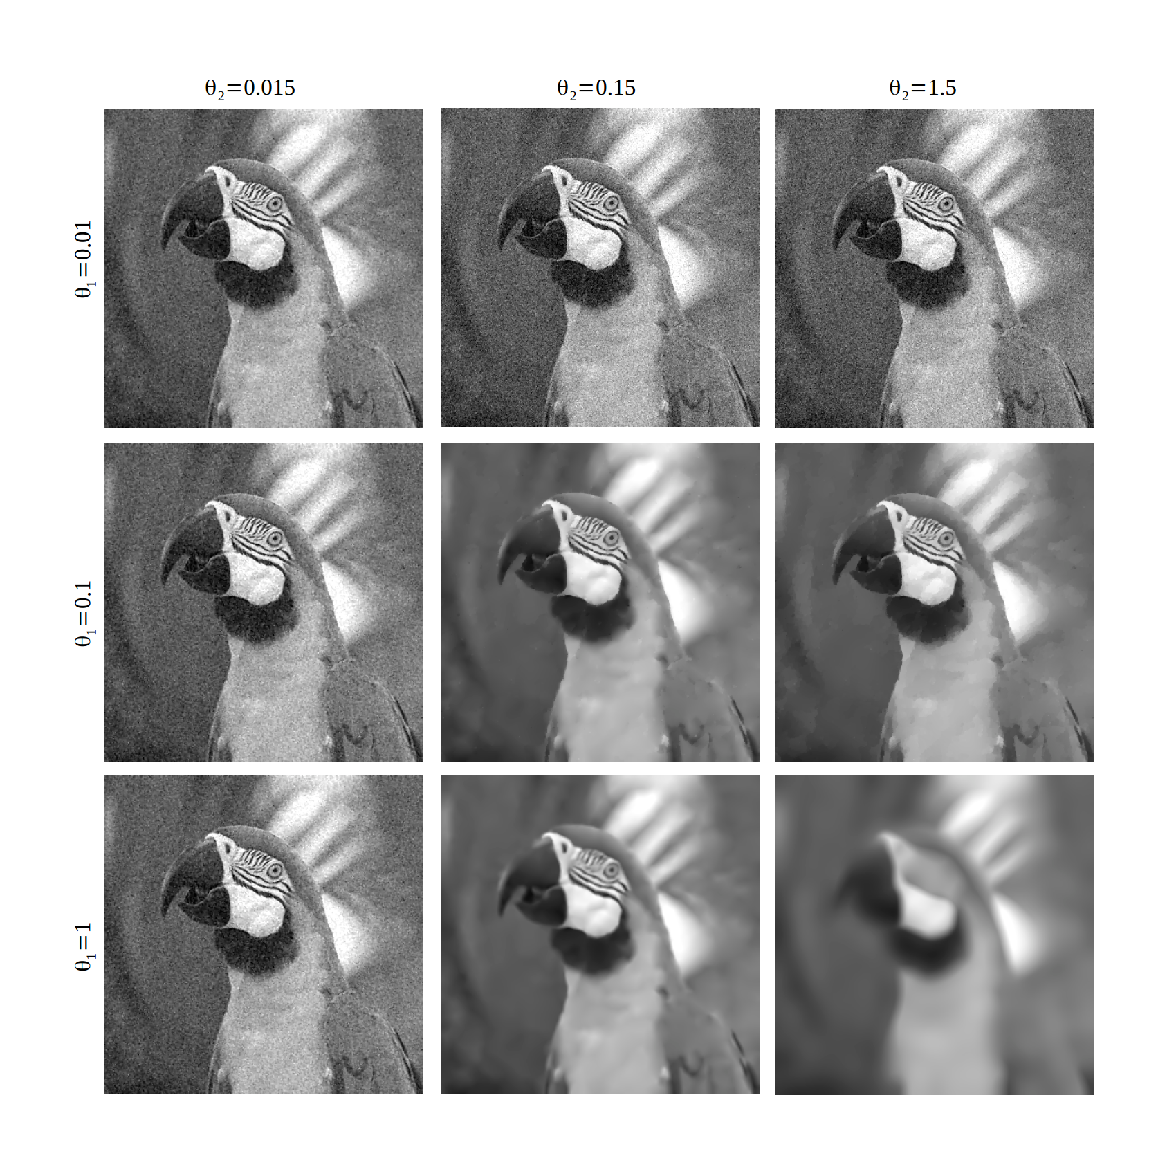
Numerical Experiments
TGV denoising
$∆ = \left(∆^{v} ,∆^{h} \right)$
discrete image-gradient
J maps the image-gradient vector field to its

Slide 34
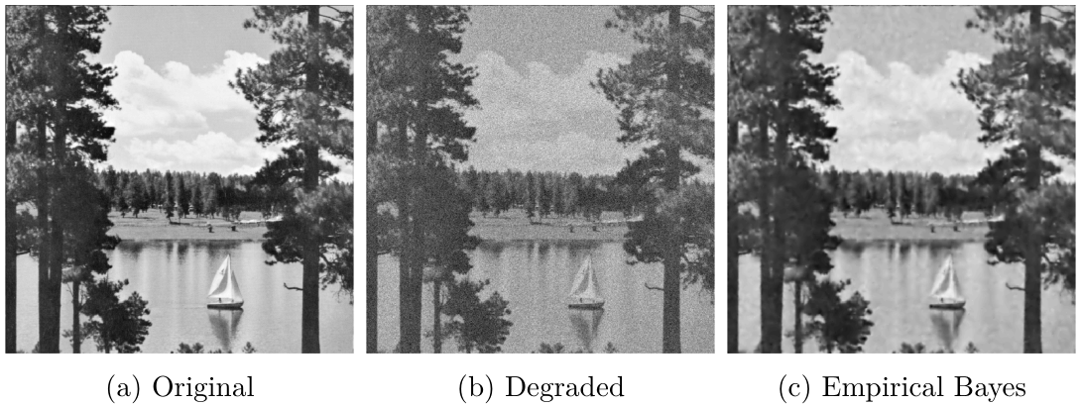
Numerical Experiments
TGV denoising

Slide 35
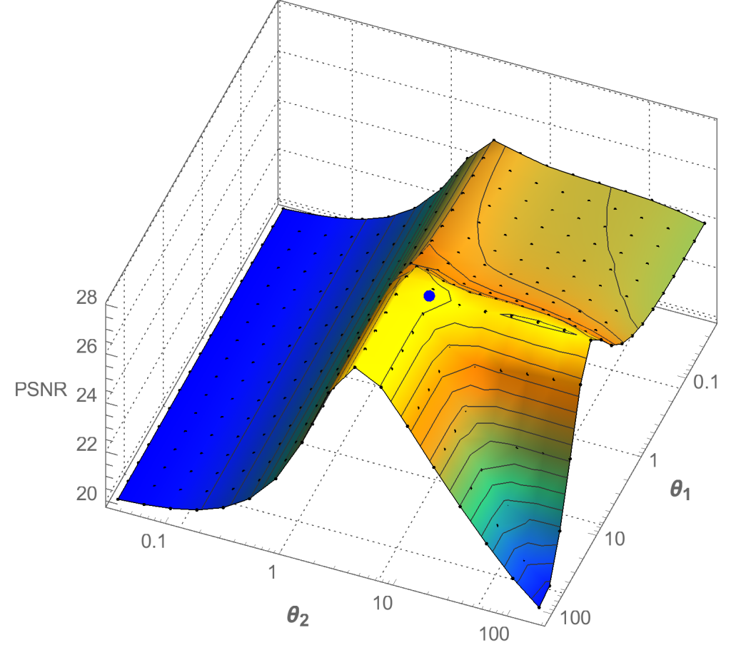
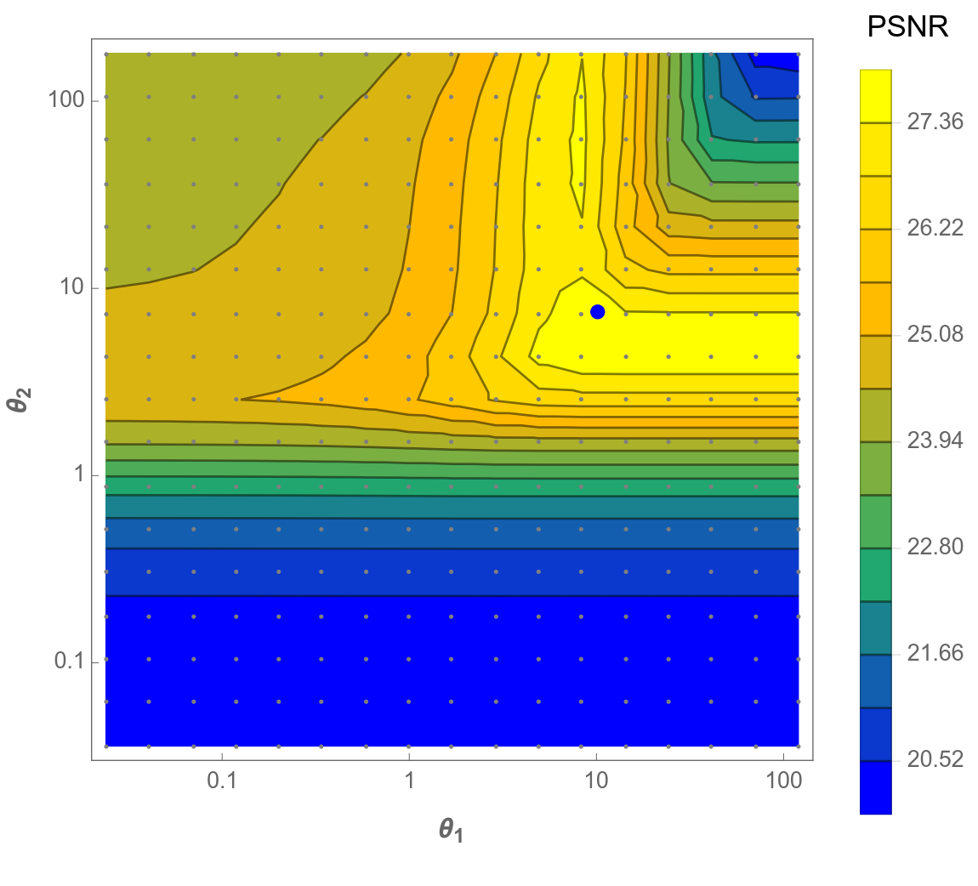
Numerical Experiments
SNR=8dB
Lake image
TGV denoising
PSNR
$$θ_{2}$$
$$θ_{1}$$
$$θ_{1}$$
$$θ_{2}$$

Slide 36
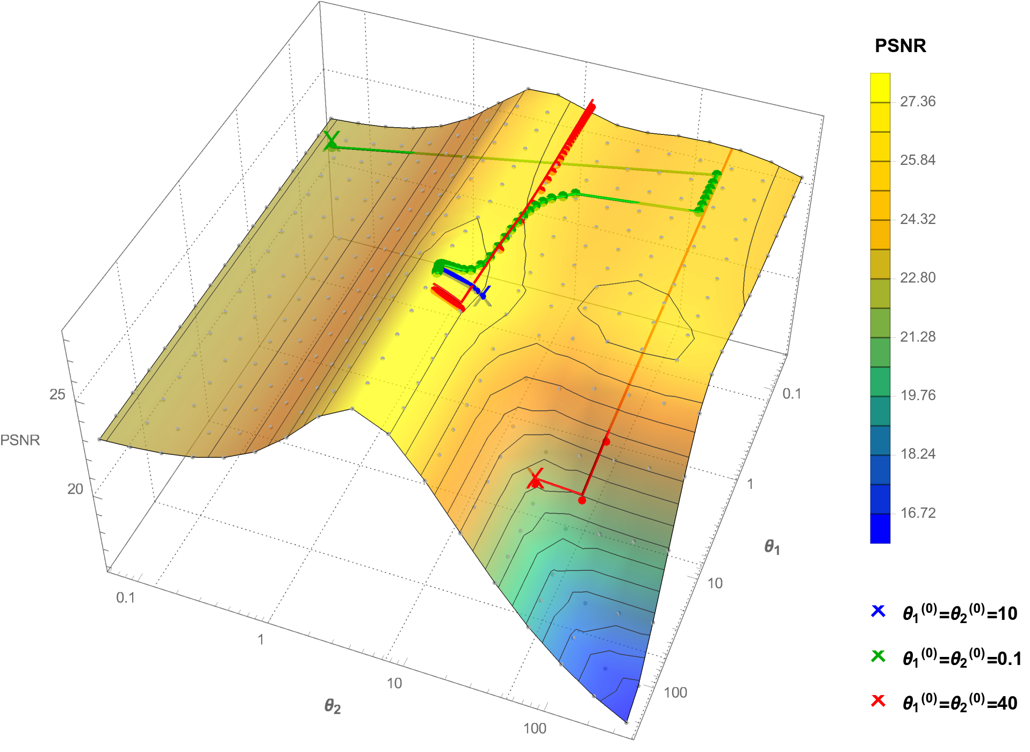
Numerical Experiments
TGV denoising
$$θ_{1}$$
SNR=8dB
Lake image
$$θ_{2}$$

Slide 37
Numerical Experiments
TGV denoising

Slide 38
Practical guidelines
When can I use this method and how? Will it actually work?
Requirements:
Convex problem. Regulariser $φ(x$) can be non-smooth, but needs to be convex.
You need to be able to compute the proximal operator of your regularisers in a reasonable time.
Potential difficulties and limitations:
Operator A is too ill-posed → requires preconditioning
When running 2 Markov chains, use thinning to achieve similar effective sample size
Extremely ill-posed problems→ MYULA Markov kernels might not work
Dimension of $θ$: we tested only 2 parameters. Limits not studied yet.
Performance:
Quality of results limited by quality of model: prior misspecification leads to poor results
Easier to use when running a single Markov chain
Works remarkably well when model is good, even for low SNR scenarios

Slide 39
Conclusions and Future Work
Summary:
$$\log{p(y|θ)}$$
$$∇_{θ}\log{p(y|θ_{ }^{ })}$$
$${\hat{θ_{ }}}_{MLE}$$
$$θ$$
Notes:
We presented an empirical Bayesian method to estimate regularisation parameters in inverse imaging problems.
We solve an intractable maximum likelihood estimation problem by proposing a stochastic optimisation algorithm.
The stochastic approximation is driven by two highly efficient proximal MCMC kernels.
The proposed methodology was illustrated with non-blind image deconvolution with TV prior and hyperspectral unmixing:
it achieved close-to-optimal performance
outperformed other state of the art approaches especially for low SNR
can be used with i) multiple parameters ii) Unknown $C(θ)$(sometimes only option)
longer computing time

Slide 40
Conclusions and Future Work
Summary:
$$\log{p(y|θ)}$$
$$∇_{θ}\log{p(y|θ_{ }^{ })}$$
$=𝔼_{x|θ_{ }}\left[φ\left(x\right) \right]$ $−$ $𝔼_{x|y,θ_{ }}\left[φ\left(x\right) \right]$
$${\hat{θ_{ }}}_{MLE}$$
$$θ$$
Notes:
We presented an empirical Bayesian method to estimate regularisation parameters in inverse imaging problems.
We solve an intractable maximum likelihood estimation problem by proposing a stochastic optimisation algorithm.
The stochastic approximation is driven by two highly efficient proximal MCMC kernels.
The proposed methodology was illustrated with non-blind image deconvolution with TV prior and hyperspectral unmixing:
it achieved close-to-optimal performance
outperformed other state of the art approaches especially for low SNR
can be used with i) multiple parameters ii) Unknown $C(θ)$(sometimes only option)
longer computing time

Slide 41
Conclusions and Future Work
Summary:
$$\log{p(y|θ)}$$
$$∇_{θ}\log{p(y|θ_{ }^{ })}$$
$=𝔼_{x|θ_{ }}\left[φ\left(x\right) \right]$ $−$ $𝔼_{x|y,θ_{ }}\left[φ\left(x\right) \right]$
$$θ$$
PRIOR
POSTERIOR
$${\hat{θ_{ }}}_{MLE}$$
$$[φ\left(U^{t+1}\right)−φ\left(X^{t+1}\right)]$$
Notes:
We presented an empirical Bayesian method to estimate regularisation parameters in inverse imaging problems.
We solve an intractable maximum likelihood estimation problem by proposing a stochastic optimisation algorithm.
The stochastic approximation is driven by two highly efficient proximal MCMC kernels.
The proposed methodology was illustrated with non-blind image deconvolution with TV prior and hyperspectral unmixing:
it achieved close-to-optimal performance
outperformed other state of the art approaches especially for low SNR
can be used with i) multiple parameters ii) Unknown $C(θ)$(sometimes only option)
longer computing time

Slide 42
Conclusions and Future Work
Summary:
$$\log{p(y|θ)}$$
$$∇_{θ}\log{p(y|θ_{ }^{ })}$$
$=𝔼_{x|θ_{ }}\left[φ\left(x\right) \right]$ $−$ $𝔼_{x|y,θ_{ }}\left[φ\left(x\right) \right]$
$$θ$$
PRIOR
POSTERIOR
$${\hat{θ_{ }}}_{MLE}$$
$$[φ\left(U^{t+1}\right)−φ\left(X^{t+1}\right)]$$
MYULA SAMPLER
Notes:
We presented an empirical Bayesian method to estimate regularisation parameters in inverse imaging problems.
We solve an intractable maximum likelihood estimation problem by proposing a stochastic optimisation algorithm.
The stochastic approximation is driven by two highly efficient proximal MCMC kernels.
The proposed methodology was illustrated with non-blind image deconvolution with TV prior and hyperspectral unmixing:
it achieved close-to-optimal performance
outperformed other state of the art approaches especially for low SNR
can be used with i) multiple parameters ii) Unknown $C(θ)$(sometimes only option)
longer computing time

Slide 43
Conclusions and Future Work
Summary:
$$\log{p(y|θ)}$$
$$∇_{θ}\log{p(y|θ_{ }^{ })}$$
$=𝔼_{x|θ_{ }}\left[φ\left(x\right) \right]$ $−$ $𝔼_{x|y,θ_{ }}\left[φ\left(x\right) \right]$
$$θ$$
PRIOR
POSTERIOR
$${\hat{θ_{ }}}_{MLE}$$
$$[φ\left(U^{t+1}\right)−φ\left(X^{t+1}\right)]$$
$φ\left(x\right)$convex, non-smooth
high-dimensions
MYULA SAMPLER
easy implementation
Just need gradients &
proximal operators
Notes:
We presented an empirical Bayesian method to estimate regularisation parameters in inverse imaging problems.
We solve an intractable maximum likelihood estimation problem by proposing a stochastic optimisation algorithm.
The stochastic approximation is driven by two highly efficient proximal MCMC kernels.
The proposed methodology was illustrated with non-blind image deconvolution with TV prior and hyperspectral unmixing:
it achieved close-to-optimal performance
outperformed other state of the art approaches especially for low SNR
can be used with i) multiple parameters ii) Unknown $C(θ)$(sometimes only option)
longer computing time

Slide 44
Conclusions and Future Work
Summary:
$$\log{p(y|θ)}$$
PRIOR
POSTERIOR
$$∇_{θ}\log{p(y|{θ^{t}}_{ }^{ })}$$
$$[φ\left(U^{t+1}\right)−φ\left(X^{t+1}\right)]$$
$$≈$$
$${\hat{θ_{ }}}_{MLE}$$
$$θ$$
EB performs remarkably well at low SNR values
Generally outperforms many other approaches
Can handle multiple regularisation parameters
Achieves close-to-optimal performance
In some problems setting up the sampler can be difficult
Although it handles very high dimensions, for extremely ill-posed and high dimensional problems it can be slow.
Notes:
We presented an empirical Bayesian method to estimate regularisation parameters in inverse imaging problems.
We solve an intractable maximum likelihood estimation problem by proposing a stochastic optimisation algorithm.
The stochastic approximation is driven by two highly efficient proximal MCMC kernels.
The proposed methodology was illustrated with non-blind image deconvolution with TV prior and hyperspectral unmixing:
it achieved close-to-optimal performance
outperformed other state of the art approaches especially for low SNR
can be used with i) multiple parameters ii) Unknown $C(θ)$(sometimes only option)
longer computing time

Slide 45
Conclusions and Future Work
Summary:
$$\log{p(y|θ)}$$
PRIOR
POSTERIOR
$$∇_{θ}\log{p(y|{θ^{t}}_{ }^{ })}$$
$$[φ\left(U^{t+1}\right)−φ\left(X^{t+1}\right)]$$
$$≈$$
$${\hat{θ_{ }}}_{MLE}$$
$$θ$$
Future Work:
- Accelerate the Markov kernels driving the stochastic approximation algorithm.
EB performs remarkably well at low SNR values
Generally outperforms many other approaches
Can handle multiple regularisation parameters
Achieves close-to-optimal performance
In some problems setting up the sampler can be difficult
Although it handles very high dimensions, for extremely ill-posed and high dimensional problems it can be slow.
Notes:
We presented an empirical Bayesian method to estimate regularisation parameters in inverse imaging problems.
We solve an intractable maximum likelihood estimation problem by proposing a stochastic optimisation algorithm.
The stochastic approximation is driven by two highly efficient proximal MCMC kernels.
The proposed methodology was illustrated with non-blind image deconvolution with TV prior and hyperspectral unmixing:
it achieved close-to-optimal performance
outperformed other state of the art approaches especially for low SNR
can be used with i) multiple parameters ii) Unknown $C(θ)$(sometimes only option)
longer computing time

Slide 46
References
[1] De Bortoli, V., Durmus, A., Pereyra, M., & Vidal, A. F. Efficient stochastic optimisation by unadjusted Langevin Monte Carlo. Application to maximum marginal likelihood and empirical Bayesian Estimation, (2019).
arXiv preprint arXiv:1906.12281.
EMPIRICAL BAYES ALGO. FOR GENERAL SMOOTH PROBLEMS. PROOFS CONVERGENCE
[2] Alain Durmus, Eric Moulines, and Marcelo Pereyra, “Efficient Bayesian computation by proximal Markov Chain Monte Carlo: when Langevin meets Moreau,” SIAM Journal on Imaging Sciences, vol. 11, no. 1, pp. 473–506, 2018.
MYULA ALGORITHM
[3] Ana Fernandez Vidal and Marcelo Pereyra. "Maximum Likelihood Estimation of Regularisation Parameters." In 2018 25th IEEE International Conference on Image Processing (ICIP), pp. 1742-1746. IEEE, 2018. EMPIRICAL BAYES ALGORITHM

Slide 47
Thank you for your time!
Questions?

Slide 48
Empirical Bayes
$$\log{p(y|θ)}$$
$$for{ θ={\hat{θ_{ }}}_{MLE} }_{ }$$
$𝔼_{x|θ_{ }}\left[φ\left(x\right) \right]$ $=$ $𝔼_{x|y,θ_{ }}\left[φ\left(x\right) \right]$
$$θ$$
$${\hat{θ_{ }}}_{MLE}$$

Slide 49
Numerical Experiments
Hyperspectral Unmixing
$$\sim N(0,σ^{2}I)$$
$$y = A x + z$$
$$np=75×75$$
$$224×np$$
$$12×np$$
$$224×12$$
SIGNATURE
DICTIONARY
$$75 pixels$$
$$12 end members \\ (materials)$$
$$75 pixels$$
$$224 freq. bands$$
$$75 pixels$$
$$75 pixels$$
FRACTIONAL
ABUNDANCES
$$y∈ℝ^{224×np=1260000}$$
$$x∈ℝ^{12×np=67500}$$
MEASUREMENTS
Iordache, Marian-Daniel, José M. Bioucas-Dias, and Antonio Plaza. "Total variation spatial regularization for sparse hyperspectral unmixing." IEEE Transactions on Geoscience and Remote Sensing 50, no. 11 (2012): 4484-4502.

Slide 50
Numerical Experiments
Hyperspectral Unmixing
$$y = A x + z$$
$$np=75×75$$
$$224×np$$
$$12×np$$
$$224×12$$
SIGNATURE
DICTIONARY
FRACTIONAL
ABUNDANCES
MEASUREMENTS
$$y∈ℝ^{224×np}$$
$$x∈ℝ^{12×np}$$
Iordache, Marian-Daniel, José M. Bioucas-Dias, and Antonio Plaza. "Total variation spatial regularization for sparse hyperspectral unmixing." IEEE Transactions on Geoscience and Remote Sensing 50, no. 11 (2012): 4484-4502.
Regularisation $→$ $θ_{TV} TV\left(x\right)$ + $θ_{1}{\left\|x\right\|}_{1}^{ } , s.t. x≥0$

Slide 51
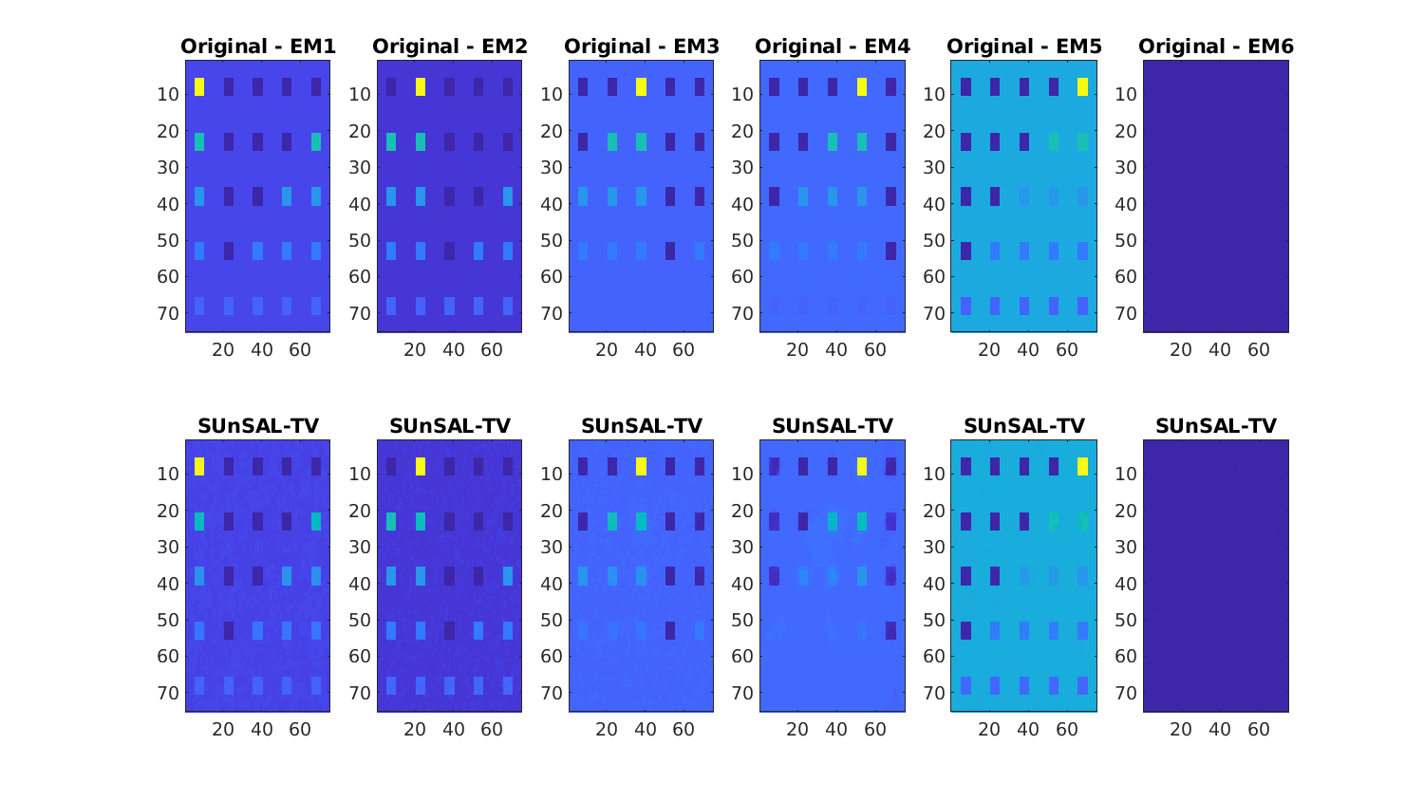
Numerical Experiments
Hyperspectral Unmixing
SNR 20dB

Slide 52
Numerical Experiments
Hyperspectral Unmixing
Signal to reconstruction error (SRE)= $\frac{{\left\|x\right\|}_{2}^{2 }}{{\left\|x−\hat{x}\right\|}_{2}^{2 }}$
Best params
Marginalisation
Empirical Bayes
SNR 20dB
SNR 30dB
SNR 40dB
SRE
SRE
SRE
$$θ_{L1}$$
$$θ_{L1}$$
$$θ_{L1}$$
$$θ_{TV}$$
$$θ_{TV}$$
$$θ_{TV}$$

Slide 53
Numerical Experiments
Best params
Hierarchical Bayes
Empirical Bayes
Hyperspectral Unmixing
SNR 20dB
SNR 30dB
SNR 40dB
SRE
SRE
SRE
$$θ_{L1}$$
$$θ_{L1}$$
$$θ_{L1}$$
$$θ_{TV}$$
$$θ_{TV}$$
$$θ_{TV}$$
EB performs remarkably well at low SNR values
Achieves close-to-optimal performance
Increased computing times
For high SNR values marginalisation is better

