Slide 1
Bayesian computation in imaging inverse problems with partially unknown models
PhD Student: Ana Fernandez Vidal
Supervisor: Dr. Marcelo Pereyra
Co-authors:
Valentin De Bortoli
Alain Durmus
PhD in Statistics
School of Mathematical and Computer Sciences
Heriot-Watt University
École normale supérieure Paris-Saclay,
CNRS, Université Paris-Saclay
Viva presentation – 4th September 2020

Slide 2
High-dimensional Inverse Problems
We want to recover $x$ from the observation $y$
NOISE
UNKNOWN
IMAGE
LINEAR
OPERATOR
$$w\sim N(0,σ^{2}I)$$
OBSERVATION
A
+
$y=Ax+w$
$$x∈ℝ^{n}$$
- rank deficient
- small eigenvalues
$$y∈ℝ^{m}$$
We measure $y$, related to $x$ by a statistical model $p\left(y | x\right):$
PROBLEM: The recovery of $x$from $y$ is ill-posed or ill-conditioned
$$p\left(y | x\right)∝e^{− \frac{{\left\|y−Ax\right\|}_{2}^{2}}{2σ^{2}}}$$
LIKELIHOOD
DATA FIDELITY

Slide 3
The Bayesian Framework
We use priors to reduce uncertainty and deliver accurate estimates.
HYPERPARAMETER
REGULARISER
$$p\left(x|θ\right)=\frac{e^{−θ g\left(x\right)}}{Z(θ)}$$
PRIOR DISTRIBUTION
$We will assume that g\left(x\right)$ is
-convex
-possibly non-smooth

Slide 4
The Bayesian Framework
We obtain the posterior using Bayes’ rule.
HYPERPARAMETER
REGULARISER
$$p\left(x|θ\right)=\frac{e^{−θ g\left(x\right)}}{Z(θ)}$$
$$p\left(y | x\right)∝e^{− \frac{{\left\|y−Ax\right\|}_{2}^{2}}{2σ^{2}}}$$
LIKELIHOOD
PRIOR DISTRIBUTION
BAYES’ RULE
$p\left(x | y,θ\right)=\frac{p\left(y|x\right)p\left(x|θ\right)}{p(y|θ)}$ $\text{∝}$ $e^{−\frac{{\left\|y−Ax\right\|}_{2}^{2}}{2σ^{2}}− θ g(x)}$
POSTERIOR
LOG-CONCAVE
4

Slide 5
Bayesian Formulation of the problem
$p\left(x | y,θ\right)$ $\text{∝}$ $e^{−\frac{{\left\|y−Ax\right\|}_{2}^{2}}{2σ^{2}}− θ g(x)}$
POSTERIOR
The predominant Bayesian approach in imaging is MAP estimation which can be computed very eﬃciently by convex optimisation:
$${\hat{x}}_{MAP} _{ }=\underset{x∈ℝ^{n}}{argmax}{p\left(x | y,θ\right)}$$
CONVEX
$${\hat{x}}_{MAP} _{ }=\underset{x∈ℝ^{n}}{argmin}{\frac{{\left\|y−Ax\right\|}_{2}^{2}}{2σ^{2}}+ θg(x)}$$
5

Slide 6
$y=Ax+w$
Variational
methods
OPTIMISATION
METHODS
$$w\sim N(0,σ^{2}I)$$
FUNCTIONAL
ANALYTICAL
Penalised MLE
Deterministic
Surrogate Methods
FREQUENTIST
Stochastic
Simulation
Point Estimation
DETERMINISTIC
Posterior Dist.
STOCHASTIC
BAYESIAN
ANALYTIC
DATA-DRIVEN
Inverse Problems
1
Thesis

Slide 7
$y=Ax+w$
Variational
methods
OPTIMISATION
METHODS
$$w\sim N(0,σ^{2}I)$$
FUNCTIONAL
ANALYTICAL
Penalised MLE
Deterministic
Surrogate Methods
FREQUENTIST
Stochastic
Simulation
Point Estimation
DETERMINISTIC
Posterior Dist.
STOCHASTIC
BAYESIAN
ANALYTIC
DATA-DRIVEN
Inverse Problems
1
Regularisation Parameters
DISCREPANCY PRINCIPLE
2
RESIDUAL
ANALYSIS
CROSS-VALIDATION
Thesis
L-CURVE
MINIMISING
MSE SURROGATE
RESIDUAL WHITENESS
SURE BASED
METHODS
G-SURE
SUGAR

Slide 8
$y=Ax+w$
Variational
methods
OPTIMISATION
METHODS
$$w\sim N(0,σ^{2}I)$$
FUNCTIONAL
ANALYTICAL
Penalised MLE
Deterministic
Surrogate Methods
FREQUENTIST
Stochastic
Simulation
Point Estimation
DETERMINISTIC
Posterior Dist.
STOCHASTIC
Marginalisation
BAYESIAN
$$p(x|y)= \int_{ℝ^{+}}^{ }{p\left(x,θ | y\right)dθ}$$
ANALYTIC
DATA-DRIVEN
Joint-MAP-estim
Inverse Problems
HIERARCHICAL
$$\left(\hat{x},\hat{θ}\right)=\underset{x,θ}{argmax}{p\left(x,θ | y\right)}$$
1
BAYESIAN
METHODS
EMPIRICAL
$${\hat{θ_{ }}}_{MLE} =\begin{matrix} \\ \begin{matrix} \\ argmax \\ θ∈Θ\end{matrix}\end{matrix}p(y|θ)$$
Regularisation Parameters
DISCREPANCY PRINCIPLE
2
RESIDUAL
ANALYSIS
CROSS-VALIDATION
Thesis
L-CURVE
MINIMISING
MSE SURROGATE
RESIDUAL WHITENESS
SURE BASED
METHODS
G-SURE
SUGAR

Slide 9
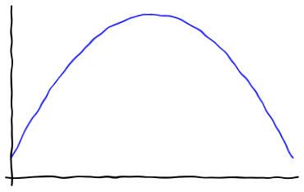
$y=Ax+w$
Variational
methods
OPTIMISATION
METHODS
$$w\sim N(0,σ^{2}I)$$
FUNCTIONAL
ANALYTICAL
Penalised MLE
Deterministic
Surrogate Methods
FREQUENTIST
Stochastic
Simulation
Point Estimation
DETERMINISTIC
Posterior Dist.
STOCHASTIC
Marginalisation
BAYESIAN
$$p(x|y)= \int_{ℝ^{+}}^{ }{p\left(x,θ | y\right)dθ}$$
ANALYTIC
DATA-DRIVEN
Joint-MAP-estim
Inverse Problems
HIERARCHICAL
$$\left(\hat{x},\hat{θ}\right)=\underset{x,θ}{argmax}{p\left(x,θ | y\right)}$$
1
BAYESIAN
METHODS
EMPIRICAL
$${\hat{θ_{ }}}_{MLE} =\begin{matrix} \\ \begin{matrix} \\ argmax \\ θ∈Θ\end{matrix}\end{matrix}p(y|θ)$$
Regularisation Parameters
DISCREPANCY PRINCIPLE
2
RESIDUAL
ANALYSIS
CROSS-VALIDATION
Thesis
L-CURVE
MINIMISING
MSE SURROGATE
RESIDUAL WHITENESS
SURE BASED
METHODS
G-SURE
Proposed Method
model
SUGAR
3
$p\left(x | y,θ\right)\text{∝}$ $e^{−\frac{{\left\|y−Ax\right\|}_{2}^{2}}{2σ^{2}}− θ g(x)}$
$$\log{p(y|θ)}$$
convex reg.
$${∇_{θ}\log{p(y|θ_{ }^{ })}}_{ }$$
$$p(y|θ)= \int_{ℝ^{n}}^{ }{p\left(y | x\right) p\left(x | θ\right)dx}$$
$$θ$$
$${\hat{θ_{ }}}_{MLE} =\begin{matrix} \\ \begin{matrix} \\ argmax \\ θ∈Θ\end{matrix}\end{matrix}p(y|θ)$$
$${\hat{θ_{ }}}_{MLE}$$
PROJECTED GRADIENT ALGORITHM
$θ_{ }^{t+1}=𝒫_{Θ}[θ_{ }^{t}+δ_{t}∇_{θ}\log{p(y|θ_{ }^{t})}$]

Slide 10
$y=Ax+w$
Variational
methods
OPTIMISATION
METHODS
$$w\sim N(0,σ^{2}I)$$
FUNCTIONAL
ANALYTICAL
Penalised MLE
Deterministic
Surrogate Methods
FREQUENTIST
Stochastic
Simulation
Point Estimation
DETERMINISTIC
Posterior Dist.
STOCHASTIC
Marginalisation
BAYESIAN
$$p(x|y)= \int_{ℝ^{+}}^{ }{p\left(x,θ | y\right)dθ}$$
ANALYTIC
DATA-DRIVEN
Joint-MAP-estim
Inverse Problems
HIERARCHICAL
$$\left(\hat{x},\hat{θ}\right)=\underset{x,θ}{argmax}{p\left(x,θ | y\right)}$$
1
BAYESIAN
METHODS
EMPIRICAL
$${\hat{θ_{ }}}_{MLE} =\begin{matrix} \\ \begin{matrix} \\ argmax \\ θ∈Θ\end{matrix}\end{matrix}p(y|θ)$$
Regularisation Parameters
DISCREPANCY PRINCIPLE
2
RESIDUAL
ANALYSIS
CROSS-VALIDATION
Thesis
L-CURVE
MINIMISING
MSE SURROGATE
RESIDUAL WHITENESS
SURE BASED
METHODS
G-SURE
Proposed Method
model
SUGAR
3
$p\left(x | y,θ\right)\text{∝}$ $e^{−\frac{{\left\|y−Ax\right\|}_{2}^{2}}{2σ^{2}}− θ g(x)}$
$$\log{p(y|θ)}$$
convex reg.
$${∇_{θ}\log{p(y|θ_{ }^{ })}}_{ }$$
$$p(y|θ)= \int_{ℝ^{n}}^{ }{p\left(y | x\right) p\left(x | θ\right)dx}$$
$$θ$$
$${\hat{θ_{ }}}_{MLE} =\begin{matrix} \\ \begin{matrix} \\ argmax \\ θ∈Θ\end{matrix}\end{matrix}p(y|θ)$$
$${\hat{θ_{ }}}_{MLE}$$
PROJECTED GRADIENT ALGORITHM
$$\frac{e^{−θ g\left(x\right)}}{Z(θ)}$$
$θ_{ }^{t+1}=𝒫_{Θ}[θ_{ }^{t}+δ_{t}∇_{θ}\log{p(y|θ_{ }^{t})}$]

Slide 11
$y=Ax+w$
Variational
methods
OPTIMISATION
METHODS
$$w\sim N(0,σ^{2}I)$$
FUNCTIONAL
ANALYTICAL
Penalised MLE
Deterministic
Surrogate Methods
FREQUENTIST
Stochastic
Simulation
Point Estimation
DETERMINISTIC
Posterior Dist.
STOCHASTIC
Marginalisation
BAYESIAN
$$p(x|y)= \int_{ℝ^{+}}^{ }{p\left(x,θ | y\right)dθ}$$
ANALYTIC
DATA-DRIVEN
Joint-MAP-estim
Inverse Problems
HIERARCHICAL
$$\left(\hat{x},\hat{θ}\right)=\underset{x,θ}{argmax}{p\left(x,θ | y\right)}$$
1
BAYESIAN
METHODS
EMPIRICAL
$${\hat{θ_{ }}}_{MLE} =\begin{matrix} \\ \begin{matrix} \\ argmax \\ θ∈Θ\end{matrix}\end{matrix}p(y|θ)$$
Regularisation Parameters
DISCREPANCY PRINCIPLE
2
RESIDUAL
ANALYSIS
CROSS-VALIDATION
Thesis
L-CURVE
MINIMISING
MSE SURROGATE
RESIDUAL WHITENESS
SURE BASED
METHODS
G-SURE
Proposed Method
model
SUGAR
3
$p\left(x | y,θ\right)\text{∝}$ $e^{−\frac{{\left\|y−Ax\right\|}_{2}^{2}}{2σ^{2}}− θ g(x)}$
$$\log{p(y|θ)}$$
convex reg.
$${∇_{θ}\log{p(y|θ_{ }^{ })}=𝔼}_{x|θ_{ }}\left[g\left(x\right) \right] − 𝔼_{x|y,θ_{ }}\left[g\left(x\right) \right]$$
EXPLICIT EXPRESSION
OR MONTE CARLO
ESTIMATES
MONTE CARLO
ESTIMATES
$${\hat{θ_{ }}}_{MLE}$$
$$θ$$
PROPOSED METHOD FOR SETTING REGULARISATION PARAMETERS
$$X^{t+1}\sim M_{θ^{t}}^{ }\left(X | y,θ_{ }^{t}, X^{t}\right)$$
POSTERIOR
$$p\left(x | y,{\hat{θ_{ }}}_{MLE}\right)$$
$$U^{t+1}\sim K_{θ^{t}}^{ }\left(U | θ_{ }^{t}, U^{t}\right)$$
PRIOR
$$p\left(x | {\hat{θ_{ }}}_{MLE}\right)$$
$${\hat{θ_{ }}}_{MLE}$$
$θ_{ }^{t+1}=𝒫_{Θ}[θ_{ }^{t}+δ_{t+1}(φ\left(U^{t+1}\right)−φ\left(X^{t+1}\right))$]

Slide 12
How to generate the samples
$$X^{t+1}\sim M_{θ^{t}}^{ }\left(X | y,θ_{ }^{t}, X^{t}\right)$$
POSTERIOR
$$U^{t+1}\sim K_{θ^{t}}^{ }\left(U | θ_{ }^{t}, U^{t}\right)$$
PRIOR
UNADJUSTED LANGEVIN ALGORITHM (ULA)
$$W^{t+1}\sim N\left(0, 𝕀 \right)$$
$$M_{θ^{ }}^{ }: x^{t+1}=x^{t}+γ{ ∇}_{x}\log{p\left(x^{t} | y,θ\right)}+\sqrt{2γ} W^{t+1}$$
$$^{−\frac{{\left\|y−Ax\right\|}_{2}^{2}}{2σ^{2}}− θ g(x)}$$
$${\tilde{g}}_{λ}(x)$$
Moreau Envelope

Slide 13
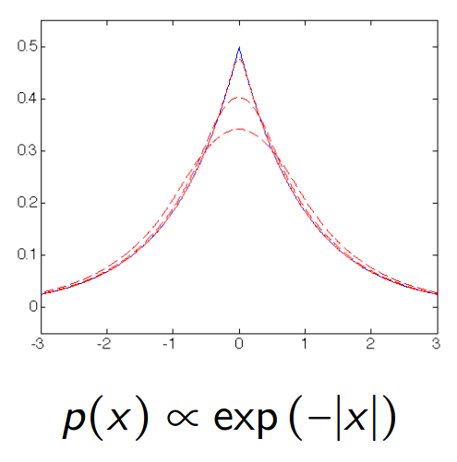
How to generate the samples
UNADJUSTED LANGEVIN ALGORITHM (ULA)
$$W^{t+1}\sim N\left(0, 𝕀 \right)$$
$$M_{θ^{ }}^{ }: x^{t+1}=x^{t}+γ{ ∇}_{x}\log{p\left(x^{t} | y,θ\right)}+\sqrt{2γ} W^{t+1}$$
$$^{−\frac{{\left\|y−Ax\right\|}_{2}^{2}}{2σ^{2}}− θ g(x)}$$
$${\tilde{g}}_{λ}(x)$$
Moreau Envelope
infimal convolution
$${\tilde{g}}_{λ}=\inf_{u∈ℝ^{d}}\left\{g\left(u\right)−{\left(2λ\right)}^{−1} {\left\|u−x\right\|}_{2}^{2}\right\}$$
Moreau-Yosida regularisation controlled by $λ$

Slide 14
How to generate the samples
$$X^{t+1}\sim M_{θ^{t}}^{ }\left(X | y,θ_{ }^{t}, X^{t}\right)$$
POSTERIOR
$$U^{t+1}\sim K_{θ^{t}}^{ }\left(U | θ_{ }^{t}, U^{t}\right)$$
PRIOR
MOREAU-YOSIDA UNADJUSTED LANGEVIN ALGORITHM (MYULA)
$$M_{θ^{ }}^{ }:{ X}^{t+1}=X^{t}−γ_{x} \left( \frac{A^{T}\left(AX^{t}−y\right)}{σ^{2}} + \frac{X^{t}−prox_{g}^{λθ}\left(X^{t}\right)}{λ} \right)+\sqrt{2γ_{x}} W^{t+1}$$
$$W^{t+1}\sim N\left(0, 𝕀 \right)$$
$${∇_{x}\tilde{g}}_{λ}(x)$$
$$∇_{x}$$
$$\frac{{\left\|y−AX^{t}\right\|}_{2}^{2}}{2σ^{2}}$$
$${ ∇}_{x}\log{p\left(x^{t} | y,θ\right)}$$
$$prox_{g}^{λθ}\left(x\right)=\underset{\tilde{x}∈ℝ^{n}}{argmin}\left\{g\left(\tilde{x}\right)+{\left\|\tilde{x}−x\right\|}_{2}^{2}/2λθ\right\}$$
14

Slide 15
How to generate the samples
$$X^{t+1}\sim M_{θ^{t}}^{ }\left(X | y,θ_{ }^{t}, X^{t}\right)$$
POSTERIOR
$$U^{t+1}\sim K_{θ^{t}}^{ }\left(U | θ_{ }^{t}, U^{t}\right)$$
PRIOR
MOREAU-YOSIDA UNADJUSTED LANGEVIN ALGORITHM (MYULA)
$$M_{θ^{ }}^{ }: X^{t+1}=X^{t}−γ_{x} \left( \frac{A^{T}\left(AX^{t}−y\right)}{σ^{2}} + \frac{X^{t}−prox_{g}^{λθ}\left(X^{t}\right)}{λ} \right)+\sqrt{2γ_{x}} W^{t+1}$$
$$K_{θ^{ }}^{ }: U^{t+1}=U^{t}−γ_{u} \left( \frac{U^{t}−prox_{g}^{λθ}\left(U^{t}\right)}{λ} \right)+\sqrt{2γ_{u}} W^{t+1}$$
arXiv:1612.07471v1 [stat.CO]
15

Slide 16
$y=Ax+w$
Variational
methods
OPTIMISATION
METHODS
$$w\sim N(0,σ^{2}I)$$
FUNCTIONAL
ANALYTICAL
Penalised MLE
Deterministic
Surrogate Methods
FREQUENTIST
Stochastic
Simulation
Point Estimation
DETERMINISTIC
Posterior Dist.
STOCHASTIC
Marginalisation
BAYESIAN
$$p(x|y)= \int_{ℝ^{+}}^{ }{p\left(x,θ | y\right)dθ}$$
ANALYTIC
DATA-DRIVEN
Joint-MAP-estim
Inverse Problems
HIERARCHICAL
$$\left(\hat{x},\hat{θ}\right)=\underset{x,θ}{argmax}{p\left(x,θ | y\right)}$$
1
BAYESIAN
METHODS
EMPIRICAL
$${\hat{θ_{ }}}_{MLE} =\begin{matrix} \\ \begin{matrix} \\ argmax \\ θ∈Θ\end{matrix}\end{matrix}p(y|θ)$$
Regularisation Parameters
DISCREPANCY PRINCIPLE
2
RESIDUAL
ANALYSIS
CROSS-VALIDATION
Thesis
L-CURVE
MINIMISING
MSE SURROGATE
RESIDUAL WHITENESS
SURE BASED
METHODS
G-SURE
Proposed Method
model
SUGAR
3
$p\left(x | y,θ\right)\text{∝}$ $e^{−\frac{{\left\|y−Ax\right\|}_{2}^{2}}{2σ^{2}}− θ g(x)}$
$$\log{p(y|θ)}$$
convex reg.
$${∇_{θ}\log{p(y|θ_{ }^{ })}=𝔼}_{x|θ_{ }}\left[g\left(x\right) \right] − 𝔼_{x|y,θ_{ }}\left[g\left(x\right) \right]$$
EXPLICIT EXPRESSION
OR MONTE CARLO
ESTIMATES
MONTE CARLO
ESTIMATES
$${\hat{θ_{ }}}_{MLE}$$
$$θ$$
PROPOSED METHOD FOR SETTING REGULARISATION PARAMETERS
$$X^{t+1}\sim M_{θ^{t}}^{ }\left(X | y,θ_{ }^{t}, X^{t}\right)$$
POSTERIOR
$$p\left(x | y,{\hat{θ_{ }}}_{MLE}\right)$$
$$U^{t+1}\sim K_{θ^{t}}^{ }\left(U | θ_{ }^{t}, U^{t}\right)$$
PRIOR
$$p\left(x | {\hat{θ_{ }}}_{MLE}\right)$$
$${\hat{θ_{ }}}_{MLE}$$
$θ_{ }^{t+1}=𝒫_{Θ}[θ_{ }^{t}+δ_{t+1}(φ\left(U^{t+1}\right)−φ\left(X^{t+1}\right))$]

Slide 17
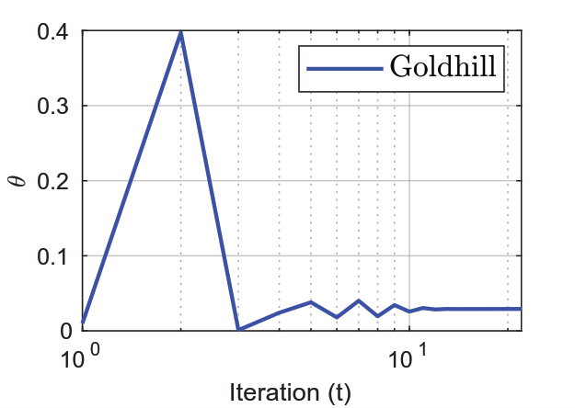
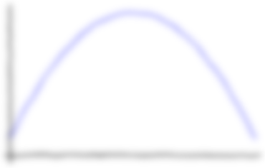
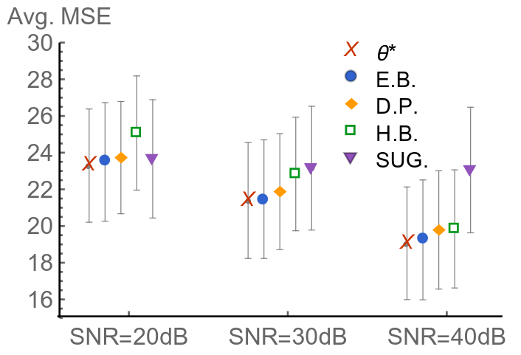
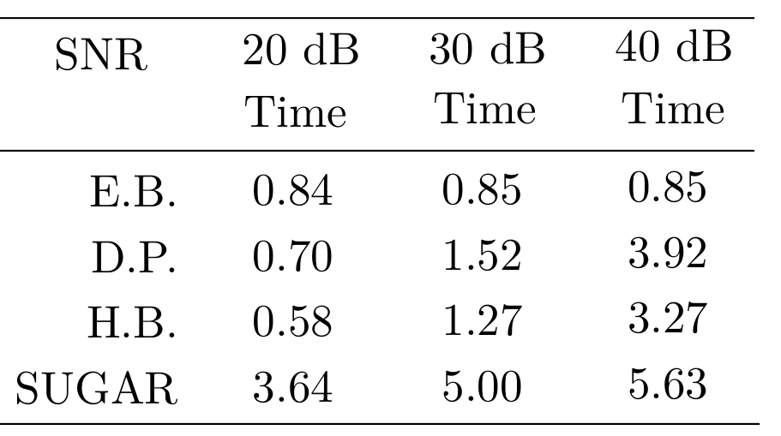
TV non-blind deconvolution
$y=Ax+w$
Variational
methods
OPTIMISATION
METHODS
$$w\sim N(0,σ^{2}I)$$
FUNCTIONAL
ANALYTICAL
Penalised MLE
Deterministic
Surrogate Methods
Regularisation $→$g$\left(x\right)=TV\left(x\right)$
FREQUENTIST
Stochastic
Simulation
Point Estimation
$$X^{t+1}\sim M_{θ^{t}}^{ }\left(X | y,θ_{ }^{t}, X^{t}\right)$$
POSTERIOR
DETERMINISTIC
Posterior Dist.
$${∇_{θ}\log{p(y|θ_{ }^{ })}≈}_{ }\frac{n}{θ}−g\left(X^{t+1}\right)$$
STOCHASTIC
Marginalisation
BAYESIAN
$$p(x|y)= \int_{ℝ^{+}}^{ }{p\left(x,θ | y\right)dθ}$$
ANALYTIC
DATA-DRIVEN
Joint-MAP-estim
$$−\frac{d}{dθ_{ }}\log{Z\left(θ\right)}=\frac{n}{k θ}$$
Inverse Problems
HIERARCHICAL
$$\left(\hat{x},\hat{θ}\right)=\underset{x,θ}{argmax}{p\left(x,θ | y\right)}$$
1
BAYESIAN
METHODS
EMPIRICAL
$${\hat{θ_{ }}}_{MLE} =\begin{matrix} \\ \begin{matrix} \\ argmax \\ θ∈Θ\end{matrix}\end{matrix}p(y|θ)$$
$g\left(x\right)$ k-homogeneous
Scalar $θ$
Regularisation Parameters
2
RESIDUAL
ANALYSIS
DISCREPANCY PRINCIPLE
Thesis
CROSS-VALIDATION
L-CURVE
MINIMISING
MSE SURROGATE
RESIDUAL WHITENESS
SURE BASED
METHODS
G-SURE
Proposed Method
model
SUGAR
3
$p\left(x | y,θ\right)\text{∝}$ $e^{−\frac{{\left\|y−Ax\right\|}_{2}^{2}}{2σ^{2}}− θ g(x)}$
Imaging Experiments
convex reg.
4
4
$$\log{p(y|θ)}$$
known $σ$
$${∇_{θ}\log{p(y|θ_{ }^{ })}=𝔼}_{x|θ_{ }}\left[g\left(x\right) \right] − 𝔼_{x|y,θ_{ }}\left[g\left(x\right) \right]$$
unknown $σ$
TV PRIOR
NON-BLIND
DEBLURRING
EXPLICIT EXPRESSION
OR MONTE CARLO
ESTIMATES
MONTE CARLO
ESTIMATES
WAVELET SYNTHESIS L1
$${\hat{θ_{ }}}_{MLE}$$
$$θ$$
min
PROPOSED METHOD FOR SETTING REGULARISATION PARAMETERS
$$X^{t+1}\sim M_{θ^{t}}^{ }\left(X | y,θ_{ }^{t}, X^{t}\right)$$
POSTERIOR
$$p\left(x | y,{\hat{θ_{ }}}_{MLE}\right)$$
$$U^{t+1}\sim K_{θ^{t}}^{ }\left(U | θ_{ }^{t}, U^{t}\right)$$
PRIOR
$$p\left(x | {\hat{θ_{ }}}_{MLE}\right)$$
$${\hat{θ_{ }}}_{MLE}$$
$θ_{ }^{t+1}=𝒫_{Θ}[θ_{ }^{t}+δ_{t+1}(φ\left(U^{t+1}\right)−φ\left(X^{t+1}\right))$]

Slide 18
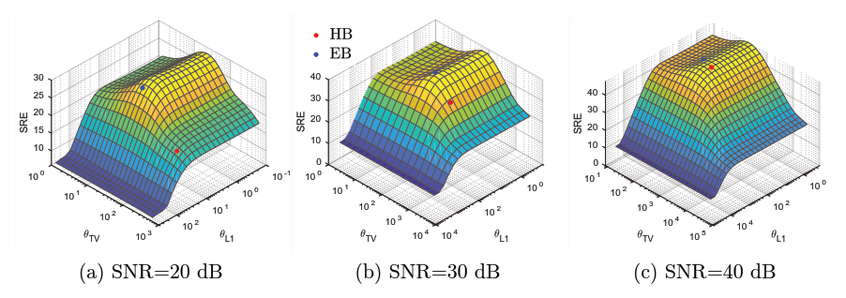
Hyperspectral Unmixing
Variational
methods
$$np=75×75$$
$y=Ax+w$
OPTIMISATION
METHODS
$$w\sim N(0,σ^{2}I)$$
FUNCTIONAL
ANALYTICAL
Penalised MLE
Deterministic
Surrogate Methods
$$y = A x + z$$
FREQUENTIST
Stochastic
Simulation
Point Estimation
$12×np$=67500
DETERMINISTIC
Posterior Dist.
STOCHASTIC
Marginalisation
$$224×np$$
BAYESIAN
$$p(x|y)= \int_{ℝ^{+}}^{ }{p\left(x,θ | y\right)dθ}$$
$$224×12$$
ANALYTIC
DATA-DRIVEN
Joint-MAP-estim
SIGNATURE
DICTIONARY
Inverse Problems
HIERARCHICAL
$$\left(\hat{x},\hat{θ}\right)=\underset{x,θ}{argmax}{p\left(x,θ | y\right)}$$
1
BAYESIAN
METHODS
EMPIRICAL
$${\hat{θ_{ }}}_{MLE} =\begin{matrix} \\ \begin{matrix} \\ argmax \\ θ∈Θ\end{matrix}\end{matrix}p(y|θ)$$
FRACTIONAL
ABUNDANCES
Regularisation Parameters
DISCREPANCY PRINCIPLE
2
RESIDUAL
ANALYSIS
CROSS-VALIDATION
MEASUREMENTS
Thesis
L-CURVE
$$x∈ℝ^{12×np}$$
RESIDUAL WHITENESS
$$y∈ℝ^{224×np}$$
MINIMISING
MSE SURROGATE
SURE BASED
METHODS
G-SURE
Proposed Method
model
SUGAR
Regularisation $→$ $θ_{TV} TV\left(x\right)$ + $θ_{1}{\left\|x\right\|}_{1}^{ }$
$s.t. x≥0$
3
$p\left(x | y,θ\right)\text{∝}$ $e^{−\frac{{\left\|y−Ax\right\|}_{2}^{2}}{2σ^{2}}− θ g(x)}$
Imaging Experiments
convex reg.
4
4
$$\log{p(y|θ)}$$
known $σ$
$${∇_{θ}\log{p(y|θ_{ }^{ })}=𝔼}_{x|θ_{ }}\left[g\left(x\right) \right] − 𝔼_{x|y,θ_{ }}\left[g\left(x\right) \right]$$
unknown $σ$
TV PRIOR
NON-BLIND
DEBLURRING
EXPLICIT EXPRESSION
OR MONTE CARLO
ESTIMATES
MONTE CARLO
ESTIMATES
WAVELET SYNTHESIS L1
$${\hat{θ_{ }}}_{MLE}$$
$$θ$$
MULTIVARIATE $θ$
HYPERSPECTRAL
UNMIXING
PROPOSED METHOD FOR SETTING REGULARISATION PARAMETERS
$$X^{t+1}\sim M_{θ^{t}}^{ }\left(X | y,θ_{ }^{t}, X^{t}\right)$$
POSTERIOR
$$p\left(x | y,{\hat{θ_{ }}}_{MLE}\right)$$
$$U^{t+1}\sim K_{θ^{t}}^{ }\left(U | θ_{ }^{t}, U^{t}\right)$$
PRIOR
$$p\left(x | {\hat{θ_{ }}}_{MLE}\right)$$
$${\hat{θ_{ }}}_{MLE}$$
$θ_{ }^{t+1}=𝒫_{Θ}[θ_{ }^{t}+δ_{t+1}(φ\left(U^{t+1}\right)−φ\left(X^{t+1}\right))$]
SNR 20dB
SNR 30dB
preconditioning
SNR 40dB

Slide 19
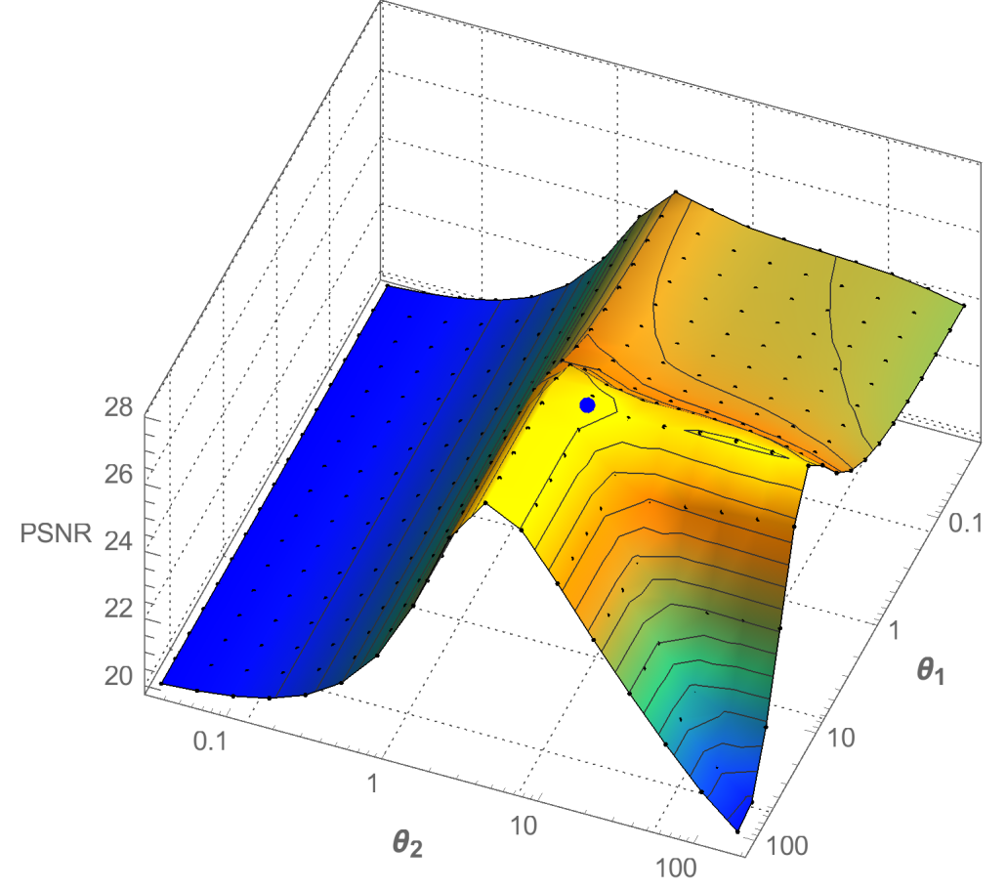
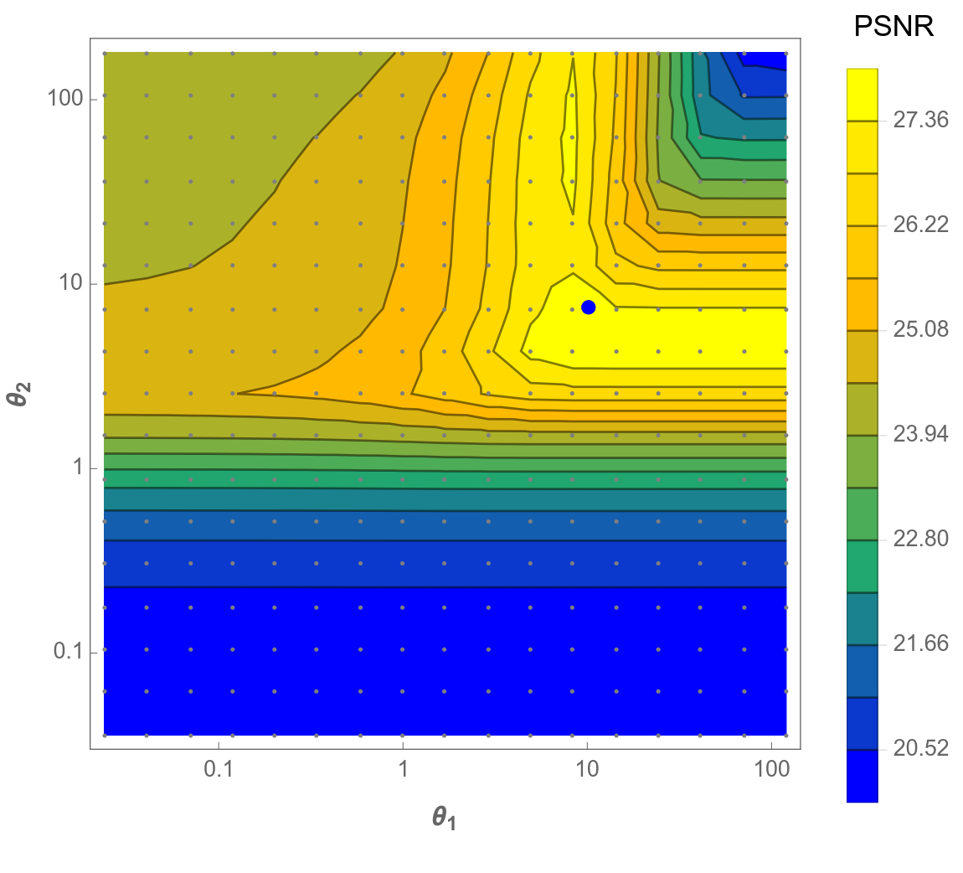
Total Generalised Variation
Variational
methods
$y=Ax+w$
OPTIMISATION
METHODS
PSNR
$$w\sim N(0,σ^{2}I)$$
FUNCTIONAL
ANALYTICAL
Penalised MLE
Deterministic
Surrogate Methods
FREQUENTIST
Stochastic
Simulation
Point Estimation
DETERMINISTIC
Posterior Dist.
STOCHASTIC
Marginalisation
BAYESIAN
$$p(x|y)= \int_{ℝ^{+}}^{ }{p\left(x,θ | y\right)dθ}$$
ANALYTIC
DATA-DRIVEN
Joint-MAP-estim
Inverse Problems
HIERARCHICAL
$$\left(\hat{x},\hat{θ}\right)=\underset{x,θ}{argmax}{p\left(x,θ | y\right)}$$
1
BAYESIAN
METHODS
EMPIRICAL
$${\hat{θ_{ }}}_{MLE} =\begin{matrix} \\ \begin{matrix} \\ argmax \\ θ∈Θ\end{matrix}\end{matrix}p(y|θ)$$
Regularisation Parameters
DISCREPANCY PRINCIPLE
$$θ_{1}$$
2
RESIDUAL
ANALYSIS
CROSS-VALIDATION
Thesis
L-CURVE
MINIMISING
MSE SURROGATE
RESIDUAL WHITENESS
SURE BASED
METHODS
G-SURE
$$θ_{2}$$
Proposed Method
model
SUGAR
3
$p\left(x | y,θ\right)\text{∝}$ $e^{−\frac{{\left\|y−Ax\right\|}_{2}^{2}}{2σ^{2}}− θ g(x)}$
Imaging Experiments
convex reg.
4
4
$$\log{p(y|θ)}$$
known $σ$
$${∇_{θ}\log{p(y|θ_{ }^{ })}=𝔼}_{x|θ_{ }}\left[g\left(x\right) \right] − 𝔼_{x|y,θ_{ }}\left[g\left(x\right) \right]$$
unknown $σ$
TV PRIOR
NON-BLIND
DEBLURRING
EXPLICIT EXPRESSION
OR MONTE CARLO
ESTIMATES
MONTE CARLO
ESTIMATES
WAVELET SYNTHESIS L1
$${\hat{θ_{ }}}_{MLE}$$
$$θ$$
MULTIVARIATE $θ$
HYPERSPECTRAL
UNMIXING
TGV-DENOISING
PROPOSED METHOD FOR SETTING REGULARISATION PARAMETERS
$$X^{t+1}\sim M_{θ^{t}}^{ }\left(X | y,θ_{ }^{t}, X^{t}\right)$$
POSTERIOR
$$p\left(x | y,{\hat{θ_{ }}}_{MLE}\right)$$
$$θ_{2}$$
$$U^{t+1}\sim K_{θ^{t}}^{ }\left(U | θ_{ }^{t}, U^{t}\right)$$
PRIOR
$$p\left(x | {\hat{θ_{ }}}_{MLE}\right)$$
$${\hat{θ_{ }}}_{MLE}$$
$θ_{ }^{t+1}=𝒫_{Θ}[θ_{ }^{t}+δ_{t+1}(φ\left(U^{t+1}\right)−φ\left(X^{t+1}\right))$]
SNR 20dB
SNR 30dB
preconditioning
SNR 40dB
$$θ_{1}$$

Slide 20
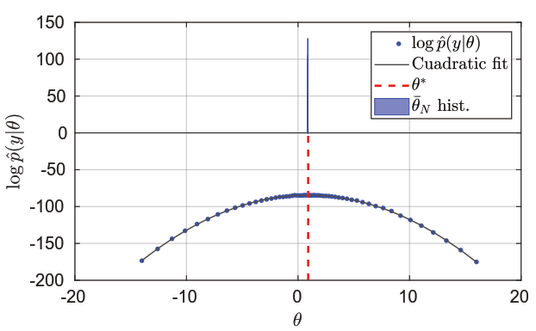
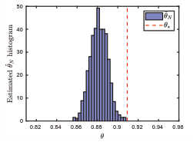
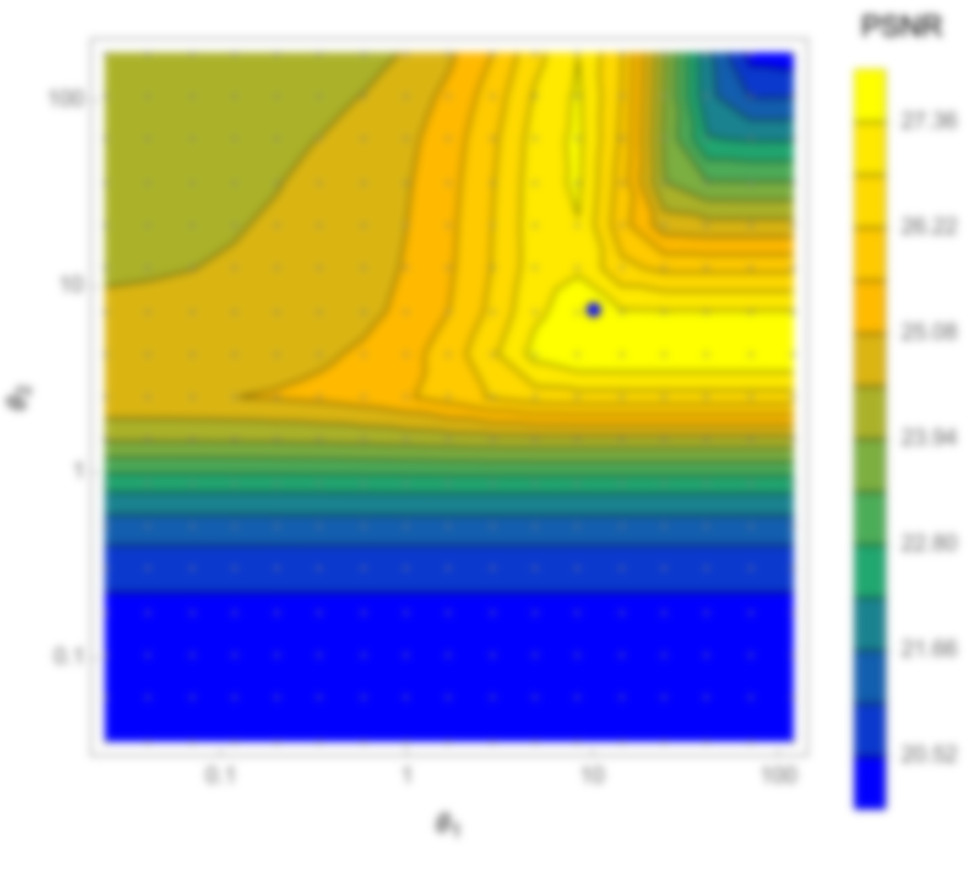
$y=Ax+w$
Variational
methods
OPTIMISATION
METHODS
$$w\sim N(0,σ^{2}I)$$
FUNCTIONAL
ANALYTICAL
Penalised MLE
Deterministic
Surrogate Methods
FREQUENTIST
Stochastic
Simulation
Bayesian Logistic Regression
Point Estimation
DETERMINISTIC
Posterior Dist.
STOCHASTIC
Marginalisation
BAYESIAN
$$p(x|y)= \int_{ℝ^{+}}^{ }{p\left(x,θ | y\right)dθ}$$
ANALYTIC
DATA-DRIVEN
Joint-MAP-estim
Inverse Problems
HIERARCHICAL
$$\left(\hat{x},\hat{θ}\right)=\underset{x,θ}{argmax}{p\left(x,θ | y\right)}$$
1
BAYESIAN
METHODS
EMPIRICAL
$${\hat{θ_{ }}}_{MLE} =\begin{matrix} \\ \begin{matrix} \\ argmax \\ θ∈Θ\end{matrix}\end{matrix}p(y|θ)$$
Regularisation Parameters
DISCREPANCY PRINCIPLE
2
RESIDUAL
ANALYSIS
CROSS-VALIDATION
Thesis
L-CURVE
BAYESIAN LOGIT REGRESSION
MINIMISING
MSE SURROGATE
RESIDUAL WHITENESS
$$p(y_{i}|β)\sim Ber(s(v_{i}^{T}β))$$
SURE BASED
METHODS
G-SURE
$$p\left(β\right|θ)\sim N(θ1_{d}, σ^{2}I_{d})$$
Non-imaging Experiments
Proposed Method
model
SUGAR
5
3
$p\left(x | y,θ\right)\text{∝}$ $e^{−\frac{{\left\|y−Ax\right\|}_{2}^{2}}{2σ^{2}}− θ g(x)}$
Imaging Experiments
convex reg.
4
4
$$\log{p(y|θ)}$$
known $σ$
$${∇_{θ}\log{p(y|θ_{ }^{ })}=𝔼}_{x|θ_{ }}\left[g\left(x\right) \right] − 𝔼_{x|y,θ_{ }}\left[g\left(x\right) \right]$$
unknown $σ$
TV PRIOR
NON-BLIND
DEBLURRING
EXPLICIT EXPRESSION
OR MONTE CARLO
ESTIMATES
MONTE CARLO
ESTIMATES
WAVELET SYNTHESIS L1
$${\hat{θ_{ }}}_{MLE}$$
$$θ$$
MULTIVARIATE $θ$
HYPERSPECTRAL
UNMIXING
TGV-DENOISING
PROPOSED METHOD FOR SETTING REGULARISATION PARAMETERS
$$X^{t+1}\sim M_{θ^{t}}^{ }\left(X | y,θ_{ }^{t}, X^{t}\right)$$
POSTERIOR
$$p\left(x | y,{\hat{θ_{ }}}_{MLE}\right)$$
$$θ_{2}$$
$$U^{t+1}\sim K_{θ^{t}}^{ }\left(U | θ_{ }^{t}, U^{t}\right)$$
PRIOR
$$p\left(x | {\hat{θ_{ }}}_{MLE}\right)$$
$${\hat{θ_{ }}}_{MLE}$$
$θ_{ }^{t+1}=𝒫_{Θ}[θ_{ }^{t}+δ_{t+1}(φ\left(U^{t+1}\right)−φ\left(X^{t+1}\right))$]
SNR 20dB
SNR 30dB
preconditioning
preconditioning
SNR 40dB
$$θ_{1}$$

Slide 21
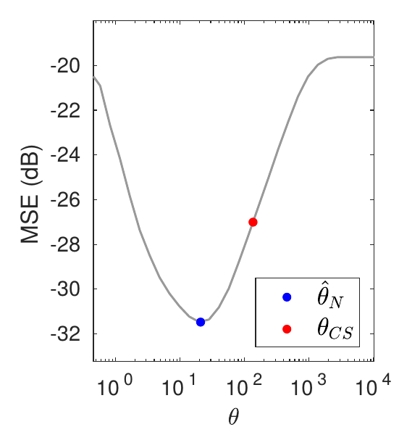
$y=Ax+w$
Variational
methods
Audio Compressive Sensing
OPTIMISATION
METHODS
$$w\sim N(0,σ^{2}I)$$
FUNCTIONAL
ANALYTICAL
Penalised MLE
Deterministic
Surrogate Methods
$y=Mz+w$
Stochastic
Simulation
$$p\left(x | y,θ\right)∝\exp\left(−\frac{{\left\|y−MΨx\right\|}_{2}^{2}}{2σ^{2}}− θ{\left\|x\right\|}_{1}\right)$$
FREQUENTIST
Point Estimation
0.15% samples
DETERMINISTIC
Posterior Dist.
STOCHASTIC
Marginalisation
BAYESIAN
$$p(x|y)= \int_{ℝ^{+}}^{ }{p\left(x,θ | y\right)dθ}$$
ANALYTIC
DATA-DRIVEN
Joint-MAP-estim
Inverse Problems
HIERARCHICAL
$$\left(\hat{x},\hat{θ}\right)=\underset{x,θ}{argmax}{p\left(x,θ | y\right)}$$
1
BAYESIAN
METHODS
EMPIRICAL
$${\hat{θ_{ }}}_{MLE} =\begin{matrix} \\ \begin{matrix} \\ argmax \\ θ∈Θ\end{matrix}\end{matrix}p(y|θ)$$
Regularisation Parameters
DISCREPANCY PRINCIPLE
2
RESIDUAL
ANALYSIS
CROSS-VALIDATION
Thesis
L-CURVE
BAYESIAN LOGIT REGRESSION
MINIMISING
MSE SURROGATE
RESIDUAL WHITENESS
$$p(y_{i}|β)\sim Ber(s(v_{i}^{T}β))$$
SURE BASED
METHODS
G-SURE
$$p\left(β\right|θ)\sim N(θ1_{d}, σ^{2}I_{d})$$
Non-imaging Experiments
Proposed Method
model
SUGAR
5
3
$p\left(x | y,θ\right)\text{∝}$ $e^{−\frac{{\left\|y−Ax\right\|}_{2}^{2}}{2σ^{2}}− θ g(x)}$
Imaging Experiments
convex reg.
4
4
$$\log{p(y|θ)}$$
known $σ$
$${∇_{θ}\log{p(y|θ_{ }^{ })}=𝔼}_{x|θ_{ }}\left[g\left(x\right) \right] − 𝔼_{x|y,θ_{ }}\left[g\left(x\right) \right]$$
AUDIO
CS
unknown $σ$
TV PRIOR
NON-BLIND
DEBLURRING
EXPLICIT EXPRESSION
OR MONTE CARLO
ESTIMATES
MONTE CARLO
ESTIMATES
WAVELET SYNTHESIS L1
$${\hat{θ_{ }}}_{MLE}$$
$$θ$$
MULTIVARIATE $θ$
HYPERSPECTRAL
UNMIXING
TGV-DENOISING
PROPOSED METHOD FOR SETTING REGULARISATION PARAMETERS
$$X^{t+1}\sim M_{θ^{t}}^{ }\left(X | y,θ_{ }^{t}, X^{t}\right)$$
POSTERIOR
$$p\left(x | y,{\hat{θ_{ }}}_{MLE}\right)$$
$$θ_{2}$$
$$U^{t+1}\sim K_{θ^{t}}^{ }\left(U | θ_{ }^{t}, U^{t}\right)$$
PRIOR
$$p\left(x | {\hat{θ_{ }}}_{MLE}\right)$$
$${\hat{θ_{ }}}_{MLE}$$
$θ_{ }^{t+1}=𝒫_{Θ}[θ_{ }^{t}+δ_{t+1}(φ\left(U^{t+1}\right)−φ\left(X^{t+1}\right))$]
SNR 20dB
SNR 30dB
preconditioning
preconditioning
SNR 40dB
$$θ_{1}$$

Slide 22
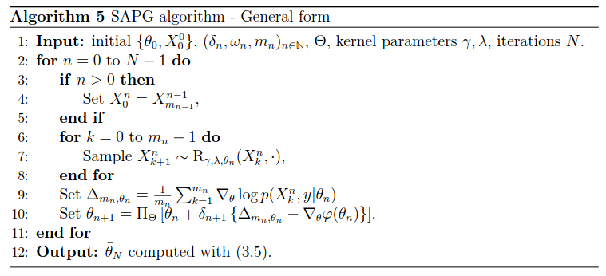
$y=Ax+w$
Variational
methods
Logistic Regression with random effects
OPTIMISATION
METHODS
$$w\sim N(0,σ^{2}I)$$
FUNCTIONAL
ANALYTICAL
Penalised MLE
Deterministic
Surrogate Methods
FREQUENTIST
Stochastic
Simulation
Point Estimation
DETERMINISTIC
Posterior Dist.
STOCHASTIC
Marginalisation
BAYESIAN
$$p(x|y)= \int_{ℝ^{+}}^{ }{p\left(x,θ | y\right)dθ}$$
ANALYTIC
DATA-DRIVEN
Joint-MAP-estim
Inverse Problems
HIERARCHICAL
$$\left(\hat{x},\hat{θ}\right)=\underset{x,θ}{argmax}{p\left(x,θ | y\right)}$$
1
BAYESIAN
METHODS
EMPIRICAL
$${\hat{θ_{ }}}_{MLE} =\begin{matrix} \\ \begin{matrix} \\ argmax \\ θ∈Θ\end{matrix}\end{matrix}p(y|θ)$$
Regularisation Parameters
DISCREPANCY PRINCIPLE
2
RESIDUAL
ANALYSIS
CROSS-VALIDATION
Thesis
L-CURVE
BAYESIAN LOGIT REGRESSION
MINIMISING
MSE SURROGATE
RESIDUAL WHITENESS
$$p(y_{i}|β)\sim Ber(s(v_{i}^{T}β))$$
SURE BASED
METHODS
G-SURE
$$p\left(β\right|θ)\sim N(θ1_{d}, σ^{2}I_{d})$$
Non-imaging Experiments
Proposed Method
model
SUGAR
5
3
$p\left(x | y,θ\right)\text{∝}$ $e^{−\frac{{\left\|y−Ax\right\|}_{2}^{2}}{2σ^{2}}− θ g(x)}$
Imaging Experiments
convex reg.
4
4
$$\log{p(y|θ)}$$
LOGIT REGRESSION + RANDOM EFFECTS
known $σ$
$${∇_{θ}\log{p(y|θ_{ }^{ })}=𝔼}_{x|θ_{ }}\left[g\left(x\right) \right] − 𝔼_{x|y,θ_{ }}\left[g\left(x\right) \right]$$
$$p(y_{i}|x,β,σ)\sim Ber(s(v_{i}^{T}β+σz_{i}^{T}x))$$
AUDIO
CS
unknown $σ$
TV PRIOR
NON-BLIND
DEBLURRING
EXPLICIT EXPRESSION
OR MONTE CARLO
ESTIMATES
MONTE CARLO
ESTIMATES
$$p(x)\sim N(0_{d},I_{d})$$
$$φ\left(β,σ\right)≈{\left\|β\right\|}_{1}$$
WAVELET SYNTHESIS L1
$${\hat{θ_{ }}}_{MLE}$$
$$θ$$
additional
penalty
MULTIVARIATE $θ$
HYPERSPECTRAL
UNMIXING
TGV-DENOISING
PROPOSED METHOD FOR SETTING REGULARISATION PARAMETERS
$$X^{t+1}\sim M_{θ^{t}}^{ }\left(X | y,θ_{ }^{t}, X^{t}\right)$$
POSTERIOR
$$p\left(x | y,{\hat{θ_{ }}}_{MLE}\right)$$
$$θ_{2}$$
$$U^{t+1}\sim K_{θ^{t}}^{ }\left(U | θ_{ }^{t}, U^{t}\right)$$
PRIOR
$$p\left(x | {\hat{θ_{ }}}_{MLE}\right)$$
$${\hat{θ_{ }}}_{MLE}$$
$θ_{ }^{t+1}=𝒫_{Θ}[θ_{ }^{t}+δ_{t+1}(φ\left(U^{t+1}\right)−φ\left(X^{t+1}\right))$]
SNR 20dB
SNR 30dB
preconditioning
preconditioning
SNR 40dB
$$θ_{1}$$

Slide 23
$y=Ax+w$
Variational
methods
OPTIMISATION
METHODS
$$w\sim N(0,σ^{2}I)$$
FUNCTIONAL
ANALYTICAL
Penalised MLE
Deterministic
Surrogate Methods
FREQUENTIST
Stochastic
Simulation
Point Estimation
DETERMINISTIC
Posterior Dist.
STOCHASTIC
Marginalisation
BAYESIAN
$$p(x|y)= \int_{ℝ^{+}}^{ }{p\left(x,θ | y\right)dθ}$$
ANALYTIC
DATA-DRIVEN
Joint-MAP-estim
PROPOSED METHOD:
DEBLURRING
TV-PRIOR
Inverse Problems
HIERARCHICAL
$$\left(\hat{x},\hat{θ}\right)=\underset{x,θ}{argmax}{p\left(x,θ | y\right)}$$
1: for every model
2: set $θ$ with Algo. 1, 2 or 3
3: compute ${\hat{x}}_{MAP}$ with $θ_{EB}$
4: calculate likelihood of ${\hat{x}}_{MAP}$
5: end for
6: pick model with highest
likelihood value
1
BAYESIAN
METHODS
EMPIRICAL
$${\hat{θ_{ }}}_{MLE} =\begin{matrix} \\ \begin{matrix} \\ argmax \\ θ∈Θ\end{matrix}\end{matrix}p(y|θ)$$
Model Selection
Regularisation Parameters
DISCREPANCY PRINCIPLE
6
2
RESIDUAL
ANALYSIS
CROSS-VALIDATION
Thesis
L-CURVE
BAYESIAN LOGIT REGRESSION
MINIMISING
MSE SURROGATE
RESIDUAL WHITENESS
$$p(y_{i}|β)\sim Ber(s(v_{i}^{T}β))$$
SURE BASED
METHODS
G-SURE
$$p\left(β\right|θ)\sim N(θ1_{d}, σ^{2}I_{d})$$
Non-imaging Experiments
Proposed Method
model
SUGAR
5
3
$p\left(x | y,θ\right)\text{∝}$ $e^{−\frac{{\left\|y−Ax\right\|}_{2}^{2}}{2σ^{2}}− θ g(x)}$
Imaging Experiments
convex reg.
4
4
$$\log{p(y|θ)}$$
LOGIT REGRESSION + RANDOM EFFECTS
known $σ$
$${∇_{θ}\log{p(y|θ_{ }^{ })}=𝔼}_{x|θ_{ }}\left[g\left(x\right) \right] − 𝔼_{x|y,θ_{ }}\left[g\left(x\right) \right]$$
$$p(y_{i}|x,β,σ)\sim Ber(s(v_{i}^{T}β+σz_{i}^{T}x))$$
AUDIO
CS
unknown $σ$
TV PRIOR
NON-BLIND
DEBLURRING
EXPLICIT EXPRESSION
OR MONTE CARLO
ESTIMATES
MONTE CARLO
ESTIMATES
$$p(x)\sim N(0_{d},I_{d})$$
$$φ\left(β,σ\right)≈{\left\|β\right\|}_{1}$$
WAVELET SYNTHESIS L1
$${\hat{θ_{ }}}_{MLE}$$
$$θ$$
additional
penalty
MULTIVARIATE $θ$
HYPERSPECTRAL
UNMIXING
TGV-DENOISING
PROPOSED METHOD FOR SETTING REGULARISATION PARAMETERS
$$X^{t+1}\sim M_{θ^{t}}^{ }\left(X | y,θ_{ }^{t}, X^{t}\right)$$
POSTERIOR
$$p\left(x | y,{\hat{θ_{ }}}_{MLE}\right)$$
$$θ_{2}$$
$$U^{t+1}\sim K_{θ^{t}}^{ }\left(U | θ_{ }^{t}, U^{t}\right)$$
PRIOR
$$p\left(x | {\hat{θ_{ }}}_{MLE}\right)$$
$${\hat{θ_{ }}}_{MLE}$$
$θ_{ }^{t+1}=𝒫_{Θ}[θ_{ }^{t}+δ_{t+1}(φ\left(U^{t+1}\right)−φ\left(X^{t+1}\right))$]
SNR 20dB
SNR 30dB
preconditioning
preconditioning
SNR 40dB
$$θ_{1}$$

Slide 24
CONCLUSIONS
FUTURE WORK
$y=Ax+w$
Variational
methods
OPTIMISATION
METHODS
New EB method for setting multiple reg. parameters automatically
Outperforms many other methods
Excellent for low SNR values
Proof of convergence - MYULA kernels
Can be used for setting other parameters e.g. $σ$
Fast for an MCMC method
Useful for model selection
Blind deconvolution
Model selection
Use in M.L. learnt priors
Compare to other methods
Exp. Propagation
Variational Bayes
Work on non-convex priors
$$w\sim N(0,σ^{2}I)$$
FUNCTIONAL
ANALYTICAL
Penalised MLE
Deterministic
Surrogate Methods
FREQUENTIST
Stochastic
Simulation
Point Estimation
DETERMINISTIC
Posterior Dist.
STOCHASTIC
Marginalisation
BAYESIAN
$$p(x|y)= \int_{ℝ^{+}}^{ }{p\left(x,θ | y\right)dθ}$$
ANALYTIC
DATA-DRIVEN
Joint-MAP-estim
PROPOSED METHOD:
DEBLURRING
TV-PRIOR
Conclusions
Future work
Inverse Problems
HIERARCHICAL
$$\left(\hat{x},\hat{θ}\right)=\underset{x,θ}{argmax}{p\left(x,θ | y\right)}$$
1: for every model
2: set $θ$ with Algo. 1, 2 or 3
3: compute ${\hat{x}}_{MAP}$ with $θ_{EB}$
4: calculate likelihood of ${\hat{x}}_{MAP}$
5: end for
6: pick model with highest
likelihood value
7
1
BAYESIAN
METHODS
EMPIRICAL
$${\hat{θ_{ }}}_{MLE} =\begin{matrix} \\ \begin{matrix} \\ argmax \\ θ∈Θ\end{matrix}\end{matrix}p(y|θ)$$
Model Selection
Regularisation Parameters
DISCREPANCY PRINCIPLE
6
2
RESIDUAL
ANALYSIS
CROSS-VALIDATION
Thesis
L-CURVE
BAYESIAN LOGIT REGRESSION
MINIMISING
MSE SURROGATE
RESIDUAL WHITENESS
$$p(y_{i}|β)\sim Ber(s(v_{i}^{T}β))$$
SURE BASED
METHODS
G-SURE
$$p\left(β\right|θ)\sim N(θ1_{d}, σ^{2}I_{d})$$
Non-imaging Experiments
Proposed Method
model
SUGAR
5
3
$p\left(x | y,θ\right)\text{∝}$ $e^{−\frac{{\left\|y−Ax\right\|}_{2}^{2}}{2σ^{2}}− θ g(x)}$
Imaging Experiments
convex reg.
4
4
$$\log{p(y|θ)}$$
LOGIT REGRESSION + RANDOM EFFECTS
known $σ$
$${∇_{θ}\log{p(y|θ_{ }^{ })}=𝔼}_{x|θ_{ }}\left[g\left(x\right) \right] − 𝔼_{x|y,θ_{ }}\left[g\left(x\right) \right]$$
$$p(y_{i}|x,β,σ)\sim Ber(s(v_{i}^{T}β+σz_{i}^{T}x))$$
AUDIO
CS
unknown $σ$
TV PRIOR
NON-BLIND
DEBLURRING
EXPLICIT EXPRESSION
OR MONTE CARLO
ESTIMATES
MONTE CARLO
ESTIMATES
$$p(x)\sim N(0_{d},I_{d})$$
$$φ\left(β,σ\right)≈{\left\|β\right\|}_{1}$$
WAVELET SYNTHESIS L1
$${\hat{θ_{ }}}_{MLE}$$
$$θ$$
additional
penalty
MULTIVARIATE $θ$
HYPERSPECTRAL
UNMIXING
TGV-DENOISING
PROPOSED METHOD FOR SETTING REGULARISATION PARAMETERS
$$X^{t+1}\sim M_{θ^{t}}^{ }\left(X | y,θ_{ }^{t}, X^{t}\right)$$
POSTERIOR
$$p\left(x | y,{\hat{θ_{ }}}_{MLE}\right)$$
$$θ_{2}$$
$$U^{t+1}\sim K_{θ^{t}}^{ }\left(U | θ_{ }^{t}, U^{t}\right)$$
PRIOR
$$p\left(x | {\hat{θ_{ }}}_{MLE}\right)$$
$${\hat{θ_{ }}}_{MLE}$$
$θ_{ }^{t+1}=𝒫_{Θ}[θ_{ }^{t}+δ_{t+1}(φ\left(U^{t+1}\right)−φ\left(X^{t+1}\right))$]
SNR 20dB
SNR 30dB
preconditioning
preconditioning
SNR 40dB
$$θ_{1}$$

Slide 25
CONCLUSIONS
FUTURE WORK
$y=Ax+w$
Variational
methods
OPTIMISATION
METHODS
New EB method for setting multiple reg. parameters automatically
Outperforms many other methods
Excellent for low SNR values
Proof of convergence - MYULA kernels
Can be used for setting other parameters e.g. $σ$
Fast for an MCMC method
Useful for model selection
Blind deconvolution
Model selection
Use in M.L. learnt priors
Compare to other methods
Exp. Propagation
Variational Bayes
Work on non-convex priors
$$w\sim N(0,σ^{2}I)$$
FUNCTIONAL
ANALYTICAL
Penalised MLE
Deterministic
Surrogate Methods
FREQUENTIST
Stochastic
Simulation
Point Estimation
DETERMINISTIC
Posterior Dist.
STOCHASTIC
Marginalisation
BAYESIAN
$$p(x|y)= \int_{ℝ^{+}}^{ }{p\left(x,θ | y\right)dθ}$$
ANALYTIC
DATA-DRIVEN
Joint-MAP-estim
PROPOSED METHOD:
DEBLURRING
TV-PRIOR
Conclusions
Future work
Inverse Problems
HIERARCHICAL
$$\left(\hat{x},\hat{θ}\right)=\underset{x,θ}{argmax}{p\left(x,θ | y\right)}$$
1: for every model
2: set $θ$ with Algo. 1, 2 or 3
3: compute ${\hat{x}}_{MAP}$ with $θ_{EB}$
4: calculate likelihood of ${\hat{x}}_{MAP}$
5: end for
6: pick model with highest
likelihood value
7
1
BAYESIAN
METHODS
EMPIRICAL
$${\hat{θ_{ }}}_{MLE} =\begin{matrix} \\ \begin{matrix} \\ argmax \\ θ∈Θ\end{matrix}\end{matrix}p(y|θ)$$
Model Selection
Regularisation Parameters
DISCREPANCY PRINCIPLE
6
2
RESIDUAL
ANALYSIS
CROSS-VALIDATION
Thesis
L-CURVE
BAYESIAN LOGIT REGRESSION
MINIMISING
MSE SURROGATE
RESIDUAL WHITENESS
$$p(y_{i}|β)\sim Ber(s(v_{i}^{T}β))$$
SURE BASED
METHODS
G-SURE
$$p\left(β\right|θ)\sim N(θ1_{d}, σ^{2}I_{d})$$
Non-imaging Experiments
Proposed Method
model
SUGAR
5
3
$p\left(x | y,θ\right)\text{∝}$ $e^{−\frac{{\left\|y−Ax\right\|}_{2}^{2}}{2σ^{2}}− θ g(x)}$
Imaging Experiments
convex reg.
4
4
$$\log{p(y|θ)}$$
LOGIT REGRESSION + RANDOM EFFECTS
known $σ$
$${∇_{θ}\log{p(y|θ_{ }^{ })}=𝔼}_{x|θ_{ }}\left[g\left(x\right) \right] − 𝔼_{x|y,θ_{ }}\left[g\left(x\right) \right]$$
$$p(y_{i}|x,β,σ)\sim Ber(s(v_{i}^{T}β+σz_{i}^{T}x))$$
AUDIO
CS
unknown $σ$
TV PRIOR
NON-BLIND
DEBLURRING
EXPLICIT EXPRESSION
OR MONTE CARLO
ESTIMATES
MONTE CARLO
ESTIMATES
$$p(x)\sim N(0_{d},I_{d})$$
$$φ\left(β,σ\right)≈{\left\|β\right\|}_{1}$$
WAVELET SYNTHESIS L1
$${\hat{θ_{ }}}_{MLE}$$
$$θ$$
additional
penalty
MULTIVARIATE $θ$
HYPERSPECTRAL
UNMIXING
TGV-DENOISING
PROPOSED METHOD FOR SETTING REGULARISATION PARAMETERS
$$X^{t+1}\sim M_{θ^{t}}^{ }\left(X | y,θ_{ }^{t}, X^{t}\right)$$
POSTERIOR
$$p\left(x | y,{\hat{θ_{ }}}_{MLE}\right)$$
$$θ_{2}$$
$$U^{t+1}\sim K_{θ^{t}}^{ }\left(U | θ_{ }^{t}, U^{t}\right)$$
PRIOR
$$p\left(x | {\hat{θ_{ }}}_{MLE}\right)$$
$${\hat{θ_{ }}}_{MLE}$$
$θ_{ }^{t+1}=𝒫_{Θ}[θ_{ }^{t}+δ_{t+1}(φ\left(U^{t+1}\right)−φ\left(X^{t+1}\right))$]
SNR 20dB
SNR 30dB
preconditioning
SNR 40dB
$$θ_{1}$$

Slide 26
Publications
[1] Vidal, A. F., De Bortoli, V., Pereyra, M., & Durmus, A., Maximum likelihood estimation of regularisation parameters in high-dimensional inverse problems: an empirical Bayesian approach. Part I: Methodology and Experiments, (2020).
arXiv preprint arXiv:1911.11709.
TO APPEAR IN SIAM JOURNAL ON IMAGING SCIENCES
[1] De Bortoli, V., Durmus, A., Pereyra, M., & Vidal, A. F., Maximum likelihood estimation of regularisation parameters in high-dimensional inverse problems: an empirical Bayesian approach. Part II: Theoretical Analysis, (2020).
arXiv preprint arXiv:2008.05793.
TO APPEAR IN SIAM JOURNAL ON IMAGING SCIENCES
[3] De Bortoli, V., Durmus, A., Pereyra, M., & Vidal, A. F. Efficient stochastic optimisation by unadjusted Langevin Monte Carlo. Application to maximum marginal likelihood and empirical Bayesian Estimation, (2019).
arXiv preprint arXiv:1906.12281.
TO APPEAR IN STATISTICS AND COMPUTING SPRINGER JOURNAL
[4] Ana Fernandez Vidal and Marcelo Pereyra. "Maximum Likelihood Estimation of Regularisation Parameters." In 2018 25th IEEE International Conference on Image Processing (ICIP), pp. 1742-1746. IEEE, 2018.

Slide 27
Thank you very much for your time!
Questions?

Slide 28
CONCLUSIONS
FUTURE WORK
$y=Ax+w$
Variational
methods
OPTIMISATION
METHODS
New EB method for setting multiple reg. parameters automatically
Outperforms many other methods
Excellent for low SNR values
Proof of convergence - MYULA kernels
Can be used for setting other parameters e.g. $σ$
Fast for an MCMC method
Useful for model selection
Blind deconvolution
Model selection
Use in M.L. learnt priors
Compare to other methods
Exp. Propagation
Variational Bayes
Work on non-convex priors
$$w\sim N(0,σ^{2}I)$$
FUNCTIONAL
ANALYTICAL
Penalised MLE
Deterministic
Surrogate Methods
FREQUENTIST
Stochastic
Simulation
Point Estimation
DETERMINISTIC
Posterior Dist.
STOCHASTIC
Marginalisation
BAYESIAN
$$p(x|y)= \int_{ℝ^{+}}^{ }{p\left(x,θ | y\right)dθ}$$
ANALYTIC
DATA-DRIVEN
Joint-MAP-estim
PROPOSED METHOD:
DEBLURRING
TV-PRIOR
Conclusions
Future work
Inverse Problems
HIERARCHICAL
$$\left(\hat{x},\hat{θ}\right)=\underset{x,θ}{argmax}{p\left(x,θ | y\right)}$$
1: for every model
2: set $θ$ with Algo. 1, 2 or 3
3: compute ${\hat{x}}_{MAP}$ with $θ_{EB}$
4: calculate likelihood of ${\hat{x}}_{MAP}$
5: end for
6: pick model with highest
likelihood value
7
1
BAYESIAN
METHODS
EMPIRICAL
$${\hat{θ_{ }}}_{MLE} =\begin{matrix} \\ \begin{matrix} \\ argmax \\ θ∈Θ\end{matrix}\end{matrix}p(y|θ)$$
Model Selection
Regularisation Parameters
DISCREPANCY PRINCIPLE
6
2
RESIDUAL
ANALYSIS
CROSS-VALIDATION
Thesis
L-CURVE
BAYESIAN LOGIT REGRESSION
MINIMISING
MSE SURROGATE
RESIDUAL WHITENESS
$$p(y_{i}|β)\sim Ber(s(v_{i}^{T}β))$$
SURE BASED
METHODS
G-SURE
$$p\left(β\right|θ)\sim N(θ1_{d}, σ^{2}I_{d})$$
Non-imaging Experiments
Proposed Method
model
SUGAR
5
3
$p\left(x | y,θ\right)\text{∝}$ $e^{−\frac{{\left\|y−Ax\right\|}_{2}^{2}}{2σ^{2}}− θ g(x)}$
Imaging Experiments
convex reg.
4
4
$$\log{p(y|θ)}$$
LOGIT REGRESSION + RANDOM EFFECTS
known $σ$
$${∇_{θ}\log{p(y|θ_{ }^{ })}=𝔼}_{x|θ_{ }}\left[g\left(x\right) \right] − 𝔼_{x|y,θ_{ }}\left[g\left(x\right) \right]$$
$$p(y_{i}|x,β,σ)\sim Ber(s(v_{i}^{T}β+σz_{i}^{T}x))$$
AUDIO
CS
unknown $σ$
TV PRIOR
NON-BLIND
DEBLURRING
EXPLICIT EXPRESSION
OR MONTE CARLO
ESTIMATES
MONTE CARLO
ESTIMATES
$$p(x)\sim N(0_{d},I_{d})$$
$$φ\left(β,σ\right)≈{\left\|β\right\|}_{1}$$
WAVELET SYNTHESIS L1
$${\hat{θ_{ }}}_{MLE}$$
$$θ$$
additional
penalty
MULTIVARIATE $θ$
HYPERSPECTRAL
UNMIXING
TGV-DENOISING
PROPOSED METHOD FOR SETTING REGULARISATION PARAMETERS
$$X^{t+1}\sim M_{θ^{t}}^{ }\left(X | y,θ_{ }^{t}, X^{t}\right)$$
POSTERIOR
$$p\left(x | y,{\hat{θ_{ }}}_{MLE}\right)$$
$$θ_{2}$$
$$U^{t+1}\sim K_{θ^{t}}^{ }\left(U | θ_{ }^{t}, U^{t}\right)$$
PRIOR
$$p\left(x | {\hat{θ_{ }}}_{MLE}\right)$$
$${\hat{θ_{ }}}_{MLE}$$
$θ_{ }^{t+1}=𝒫_{Θ}[θ_{ }^{t}+δ_{t+1}(φ\left(U^{t+1}\right)−φ\left(X^{t+1}\right))$]
SNR 20dB
SNR 30dB
preconditioning
SNR 40dB
$$θ_{1}$$

